Slide 1
High-throughput experiments elucidate the impact of multicomponent interactions on solute transport in complex feed streams.
Target Journal: Nature Water
Laurianne Estrada, Jonathan A. Ouimet, Zhicheng Lu, Molly Dougher, Shammah Lilonfe, Alexander Dowling, William Phillip
Experimental Results - Analyzed

Slide 2
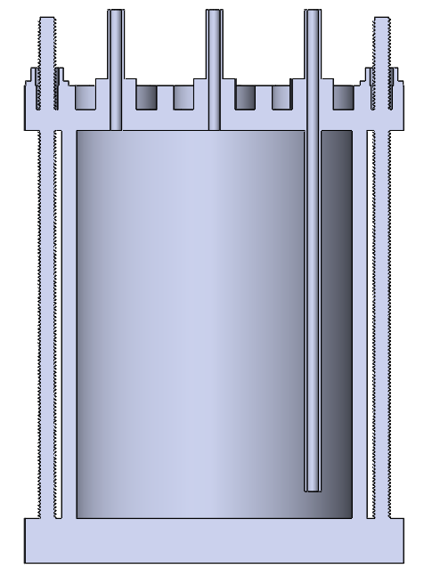
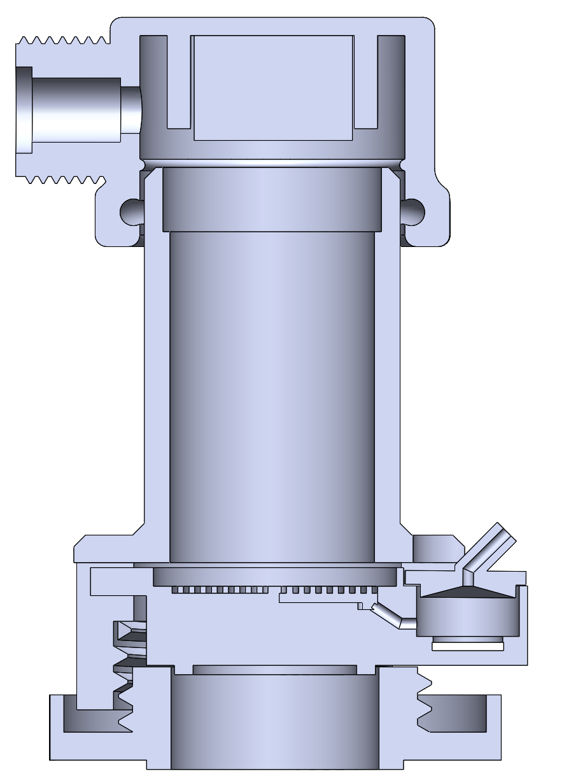
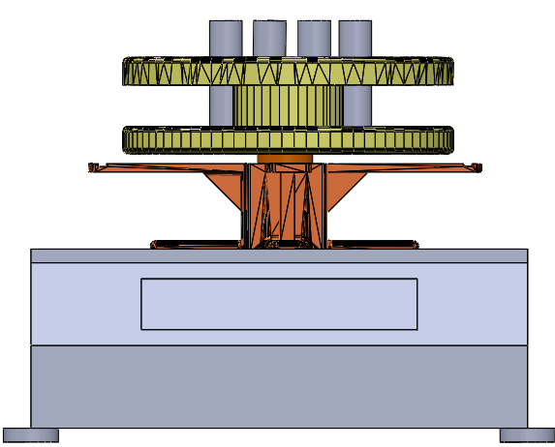

Diafiltration Experiments are Run in a Modified Stirred Cell Apparatus.
Pressure Relief Valve
P
Pressure Gauge
Stirred Cell
Scintillation Vials
Diafiltrate Tank
Permeate Outlet
Motor
Retentate Probe
Balance
Membrane
Permeate Probe
Multiple (two) salts are now placed within the feed and diafiltrate reservoirs.
Retentate and permeate conductivity data are obtained at 5 second intervals.
Scintillation vials are analyzed after the experiment (ICP-OES) to get ion specific concentrations.

Slide 3
Single Salt
Sodium Chloride Experiments

Slide 4
Legend
Permeability probe conductivity
Retentate probe conductivity
ICP feed and retentate
Bulk permeate conductivity
ICP permeate
Retentate mass balance
Color depends on the salt
ICP feed and retentate
ICP permeate
Stirred cell mass balance
X

Slide 5
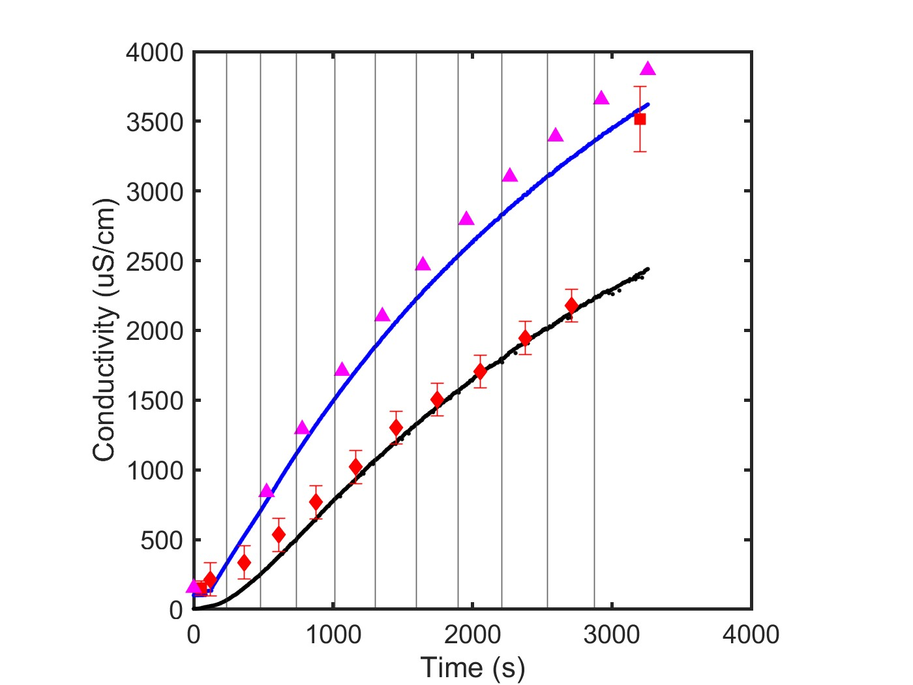
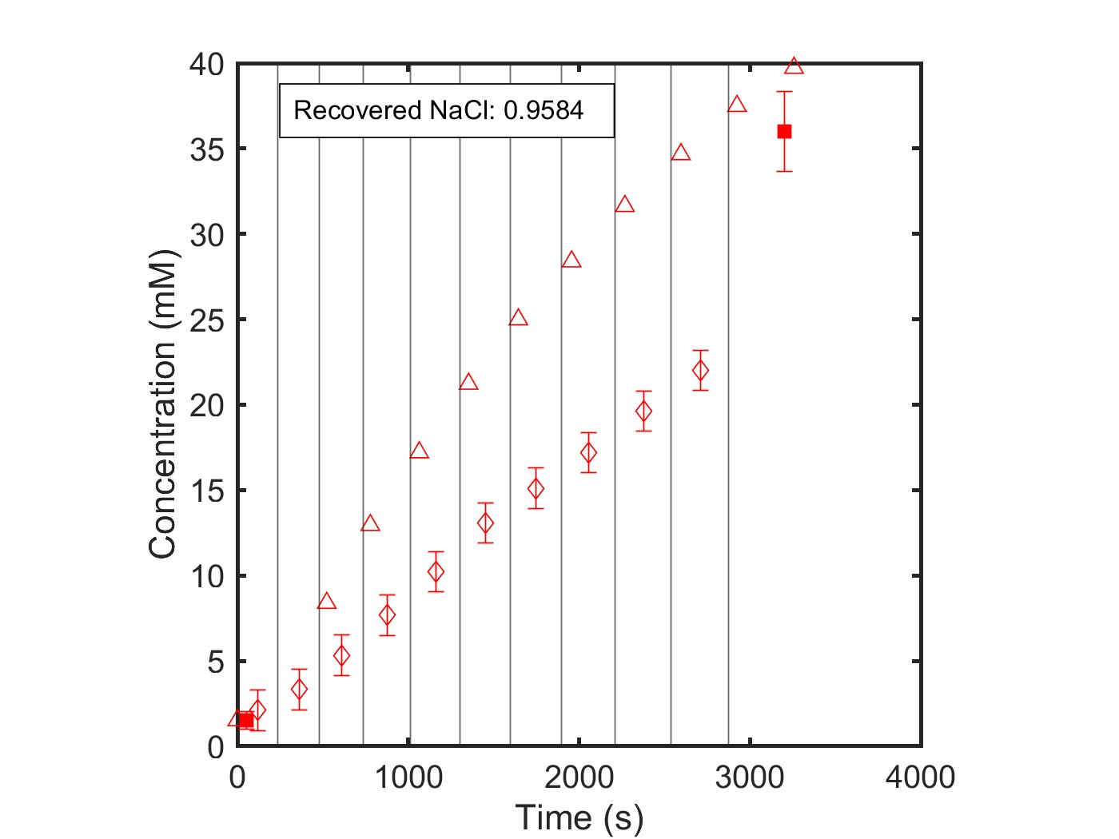
NF270_MC2, 05.07.24_NaCl
Data Quality: Good
Single Salt: NaCl
Feed: 1 mM
Diafiltrate: 50 mM

Slide 6
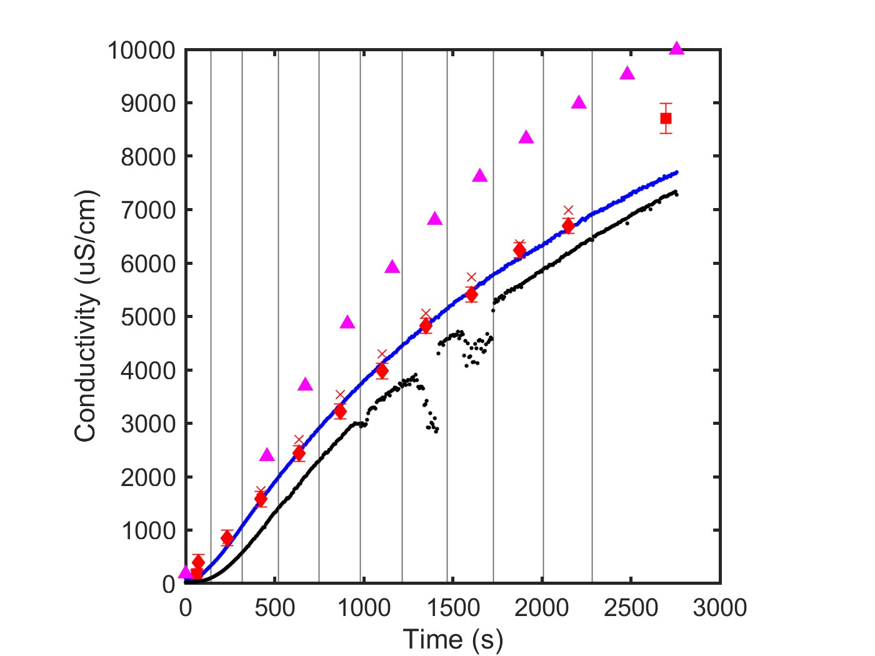
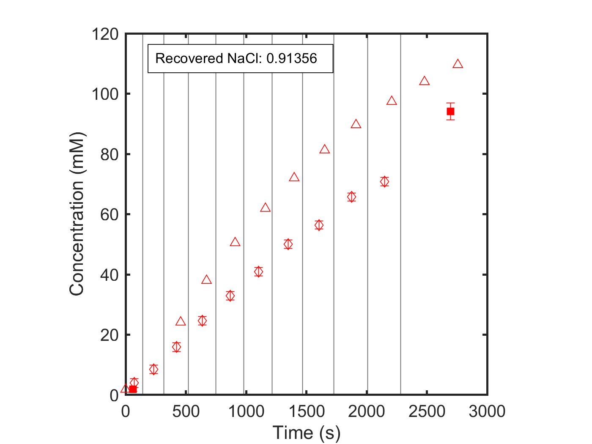
NF270_MC3, 07.09.24_NaCl
Data Quality: Bad
Single Salt: NaCl
Feed: 1 mM NaCl
Diafiltrate: 150 mM NaCl

Slide 7
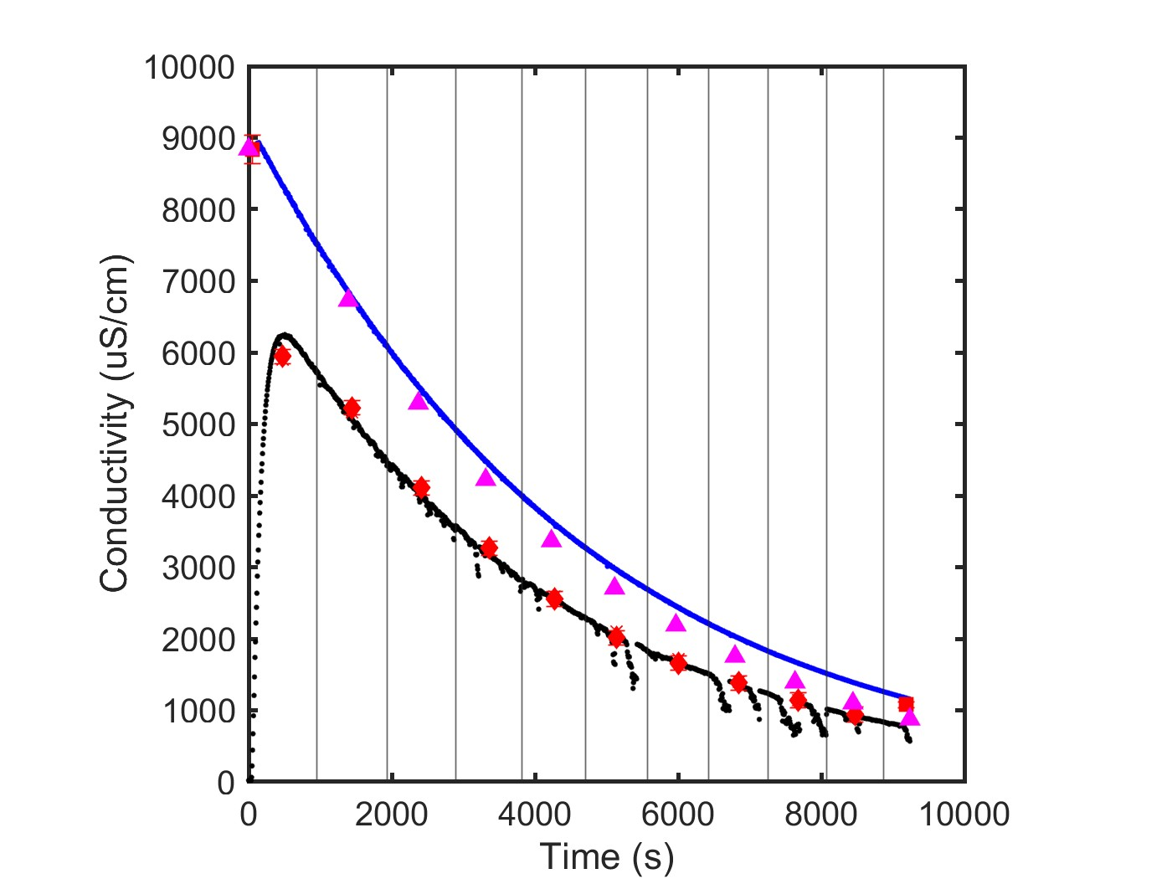
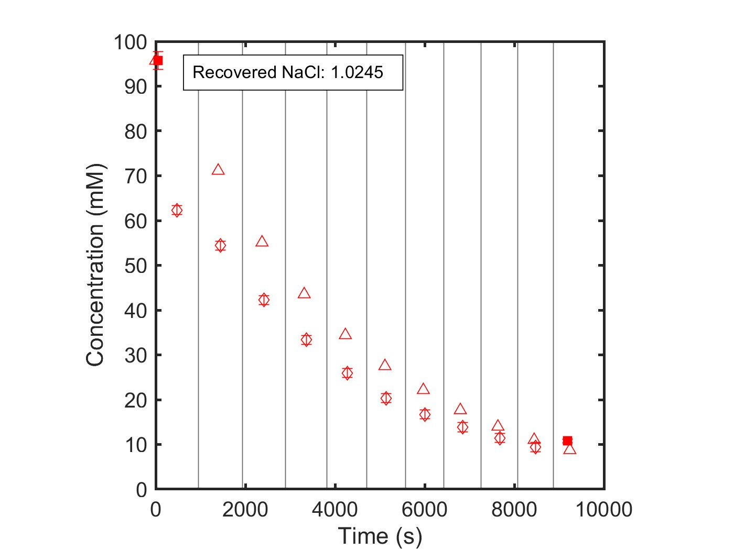
NF270_MC3, 07.22.24_SNaCl
Data Quality: Excellent
Single Salt: NaCl
Feed: 150 mM NaCl
Diafiltrate: milliQ water (0 mM NaCl)

Slide 8
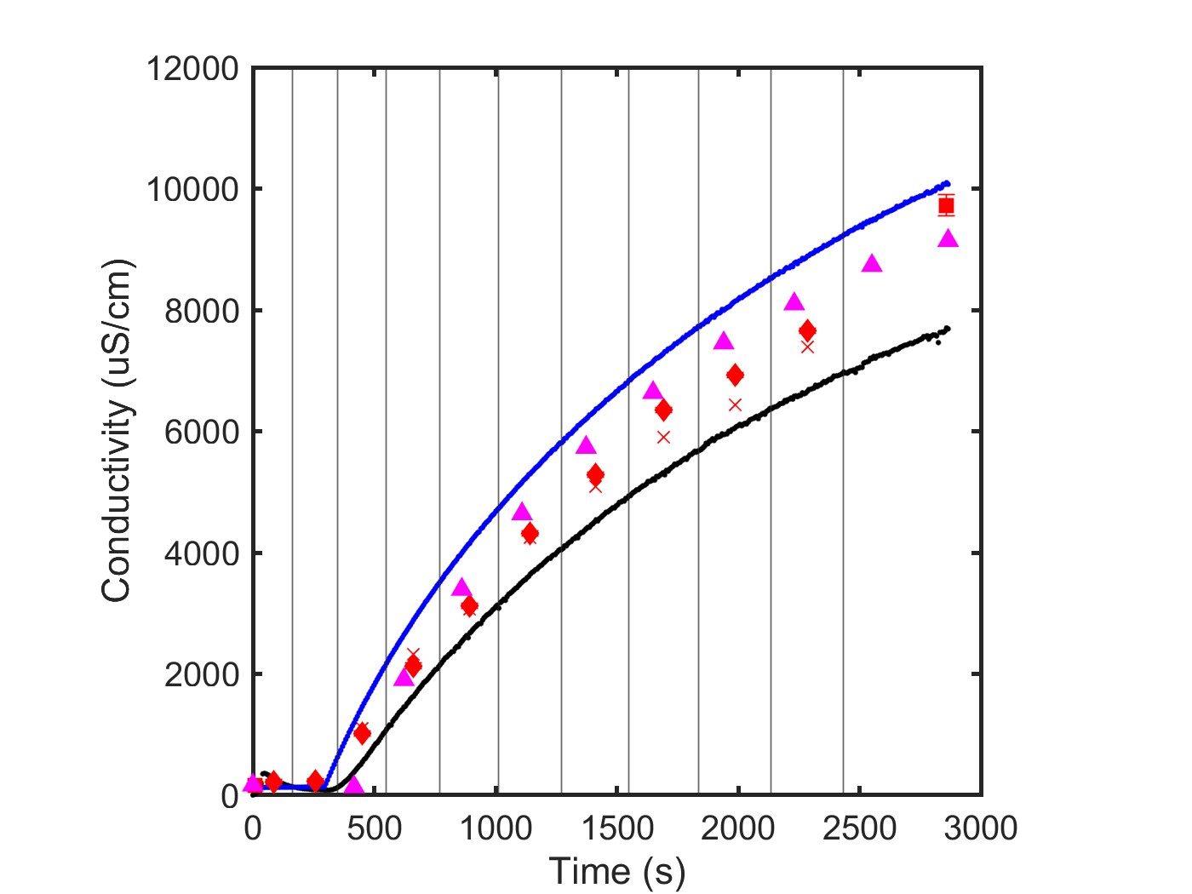
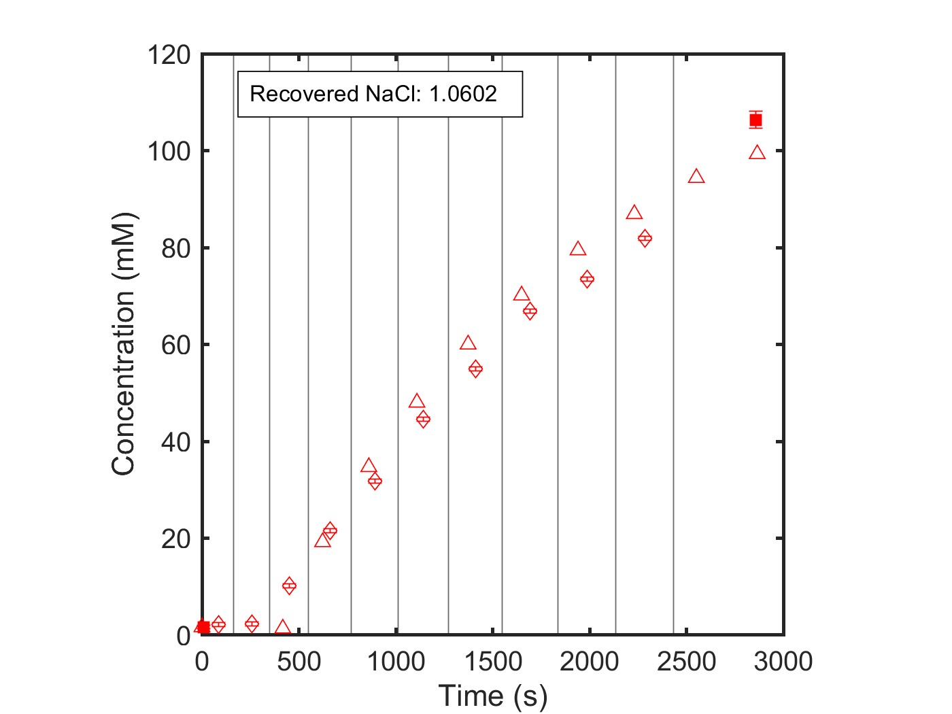
NF270_MC4, 07.11.24_SNaCl
Data Quality: Good
Single Salt: NaCl
Feed: 1 mM NaCl
Diafiltrate: 150 mM NaCl

Slide 9
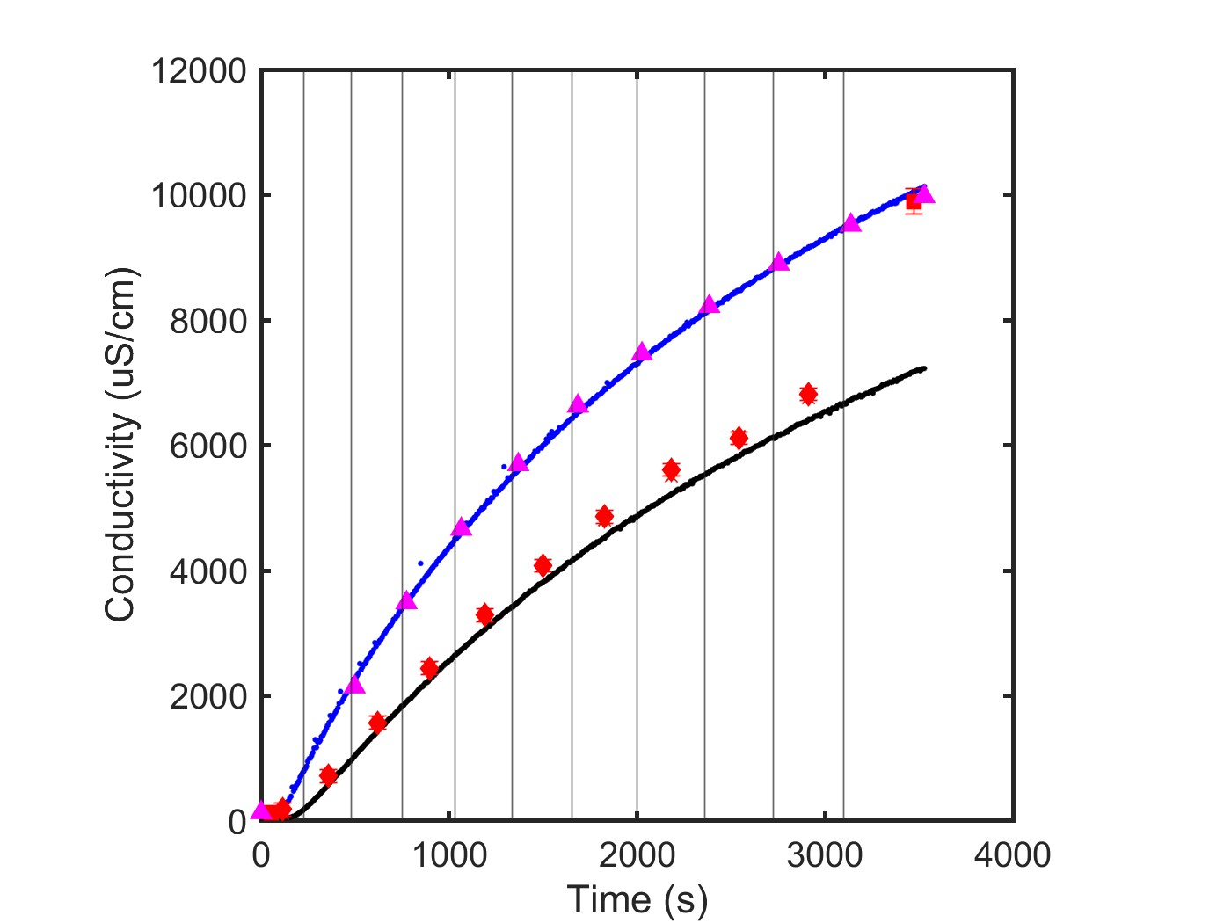
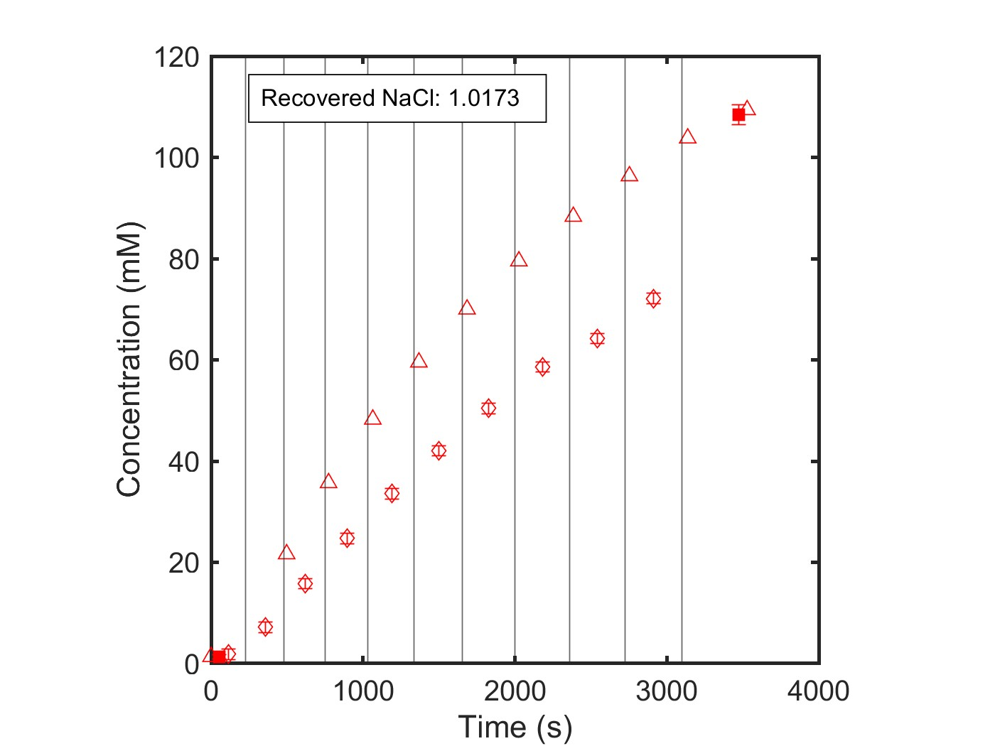
NF270_MC5, 07.23.24_NaCl
Data Quality: Excellent
Single Salt: NaCl
Feed: 1 mM NaCl
Diafiltrate: 150 mM NaCl

Slide 10
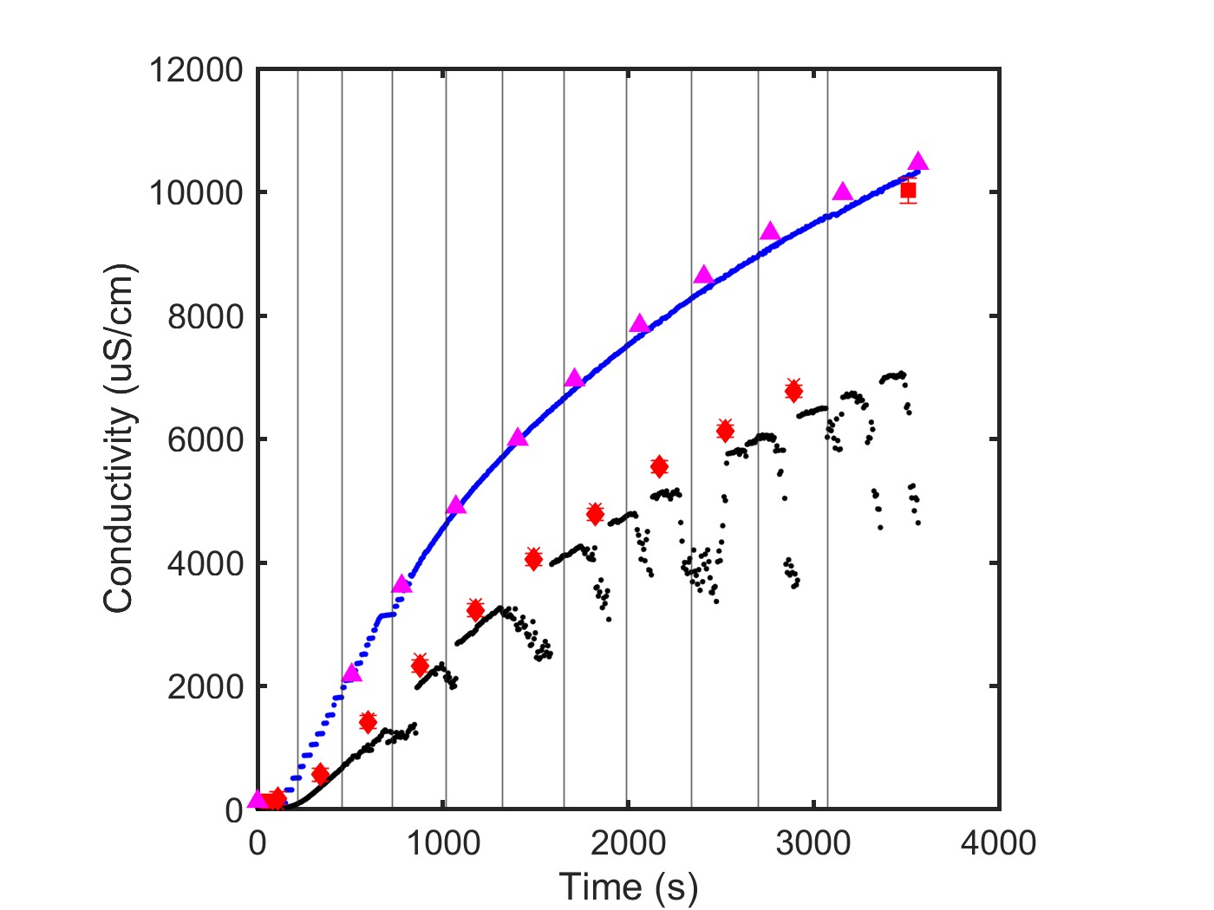
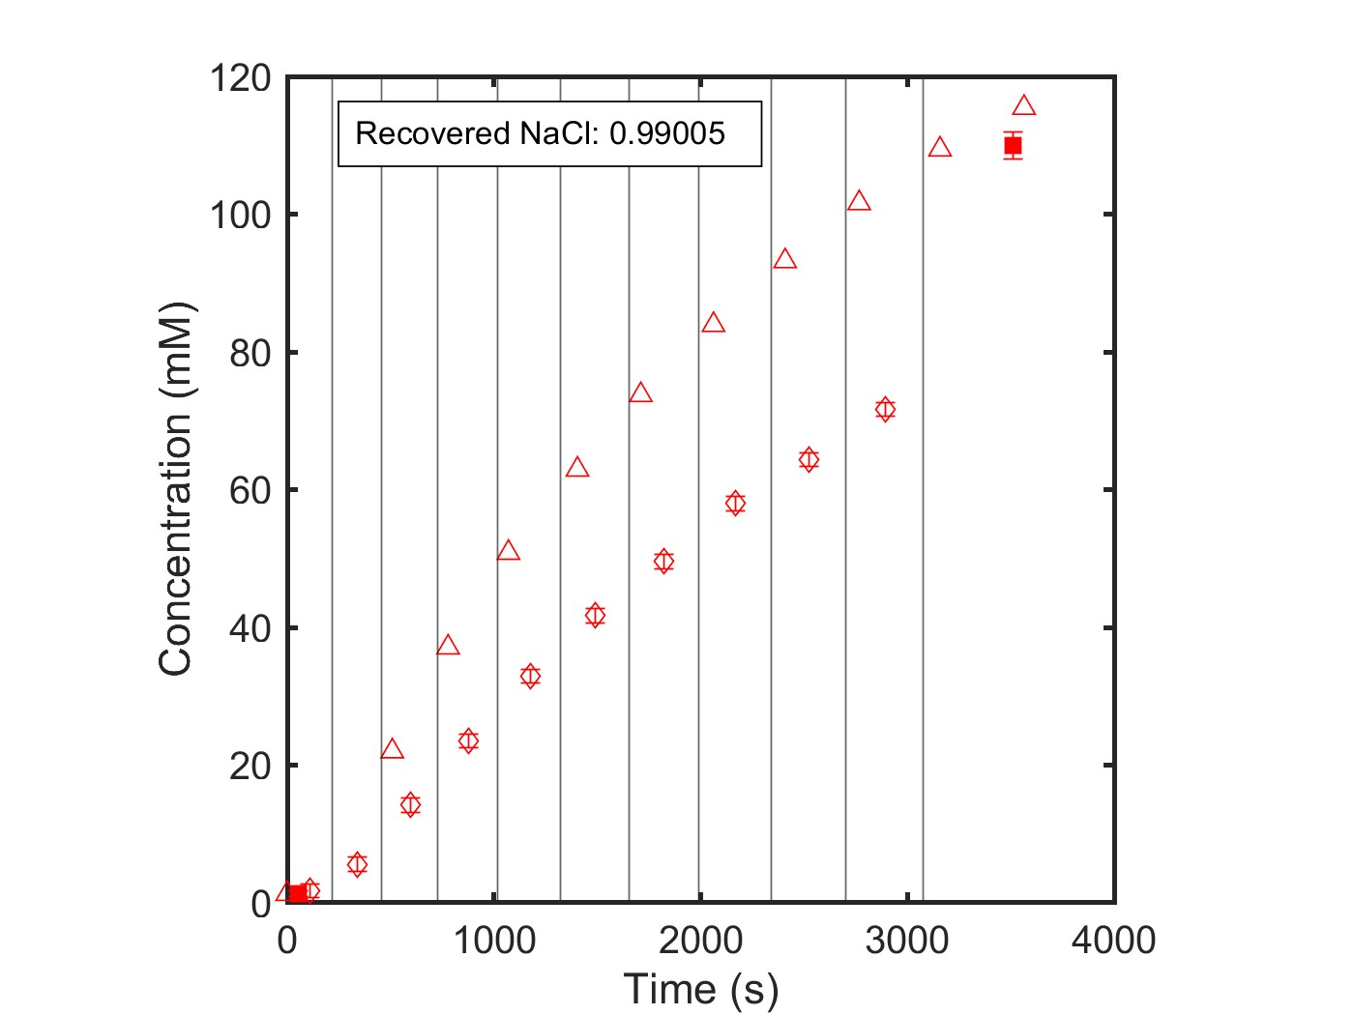
NF270_MC5, 07.23.24_SNaCl
Data Quality: Good
Single Salt: NaCl
Feed: 1 mM NaCl
Diafiltrate: 150 mM NaCl

Slide 11
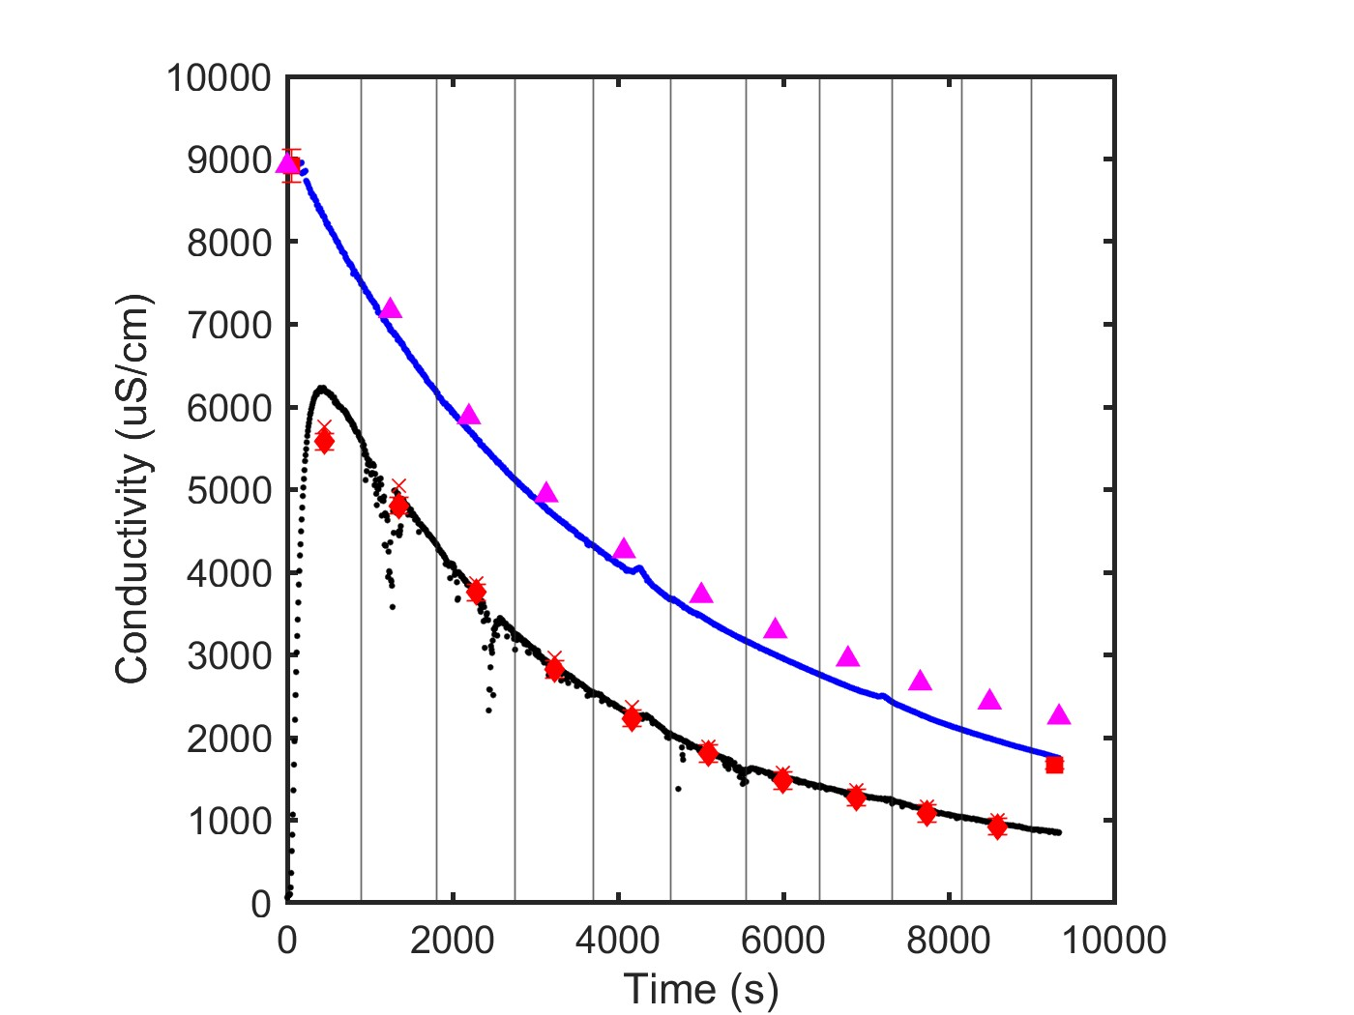
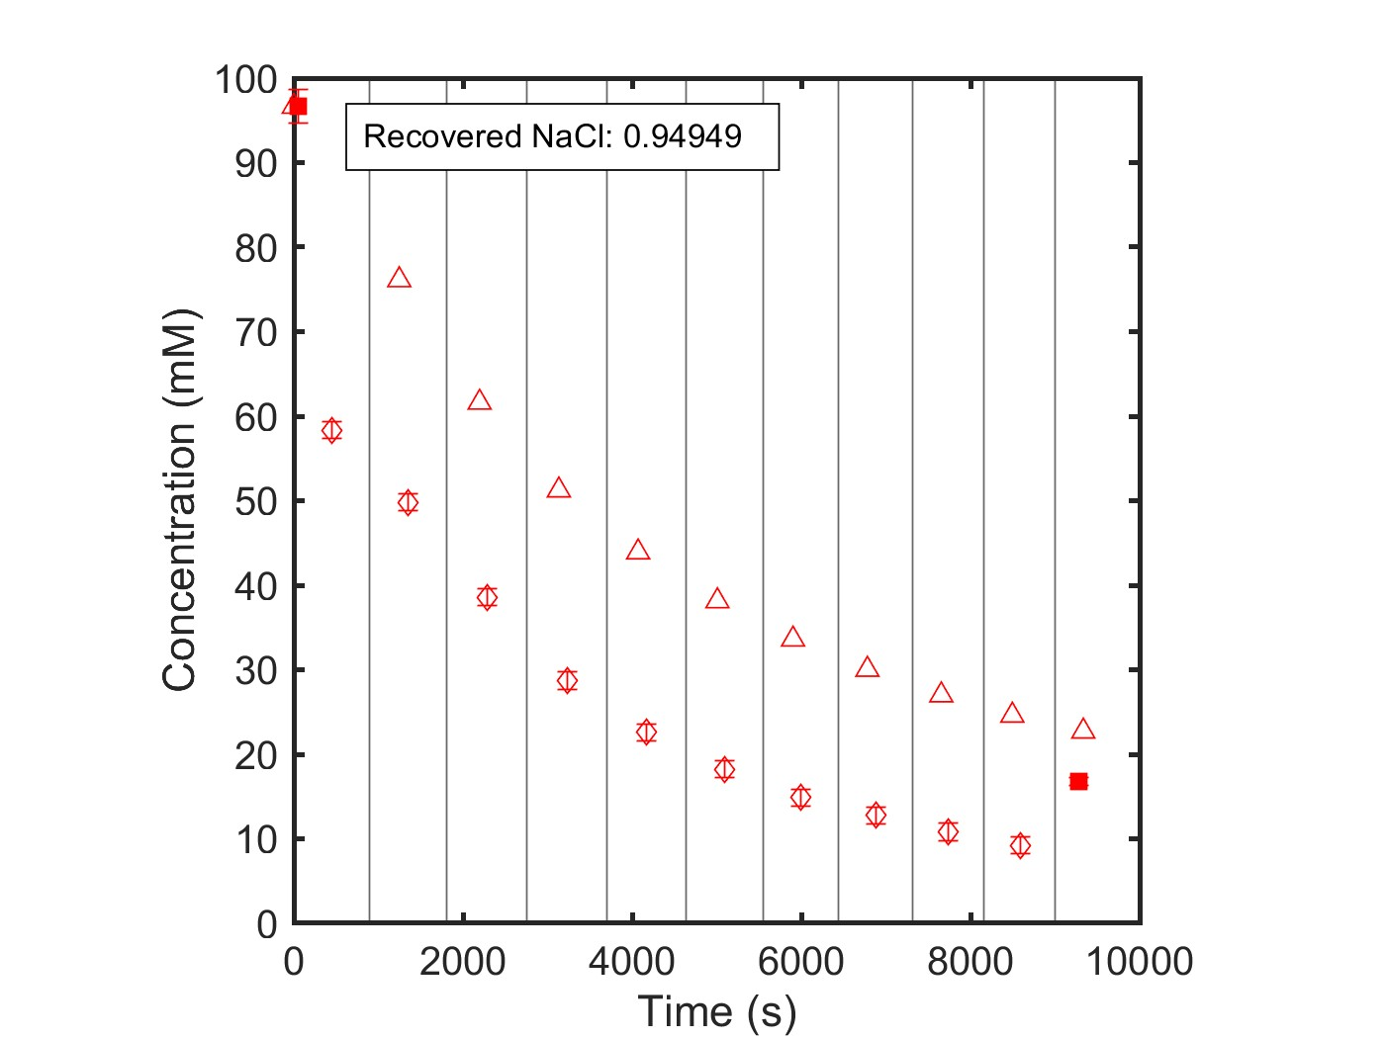
NF270_MC5, 07.23.24_S2NaCl
Data Quality: Excellent
Single Salt: NaCl
Feed: 100 mM NaCl
Diafiltrate: milliQ (0 mM NaCl)

Slide 12
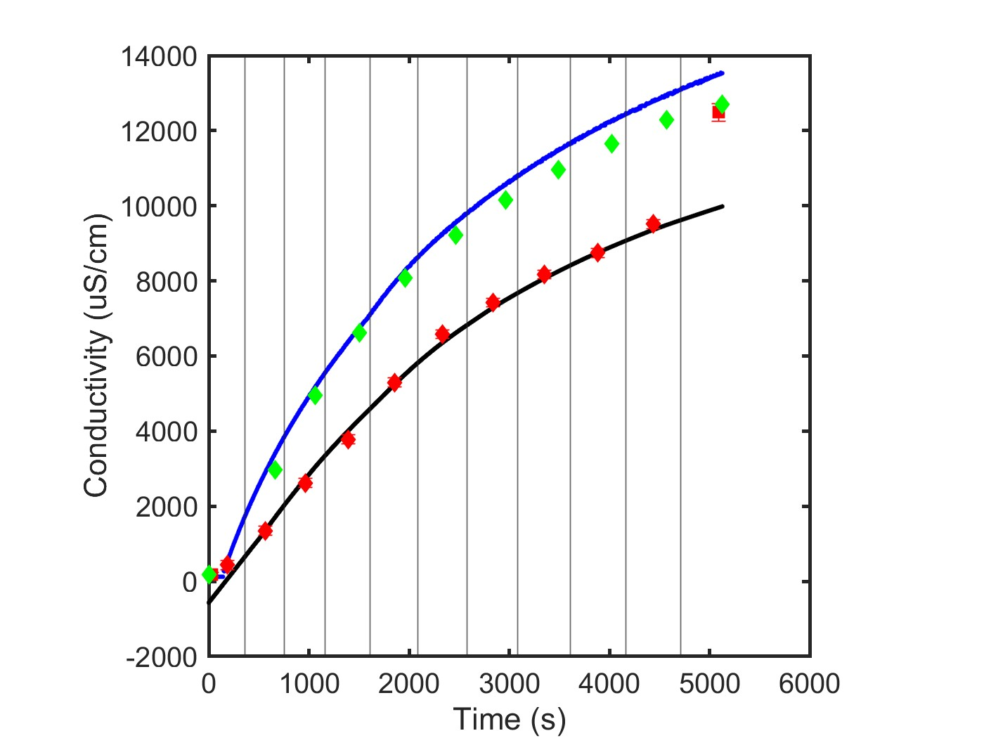
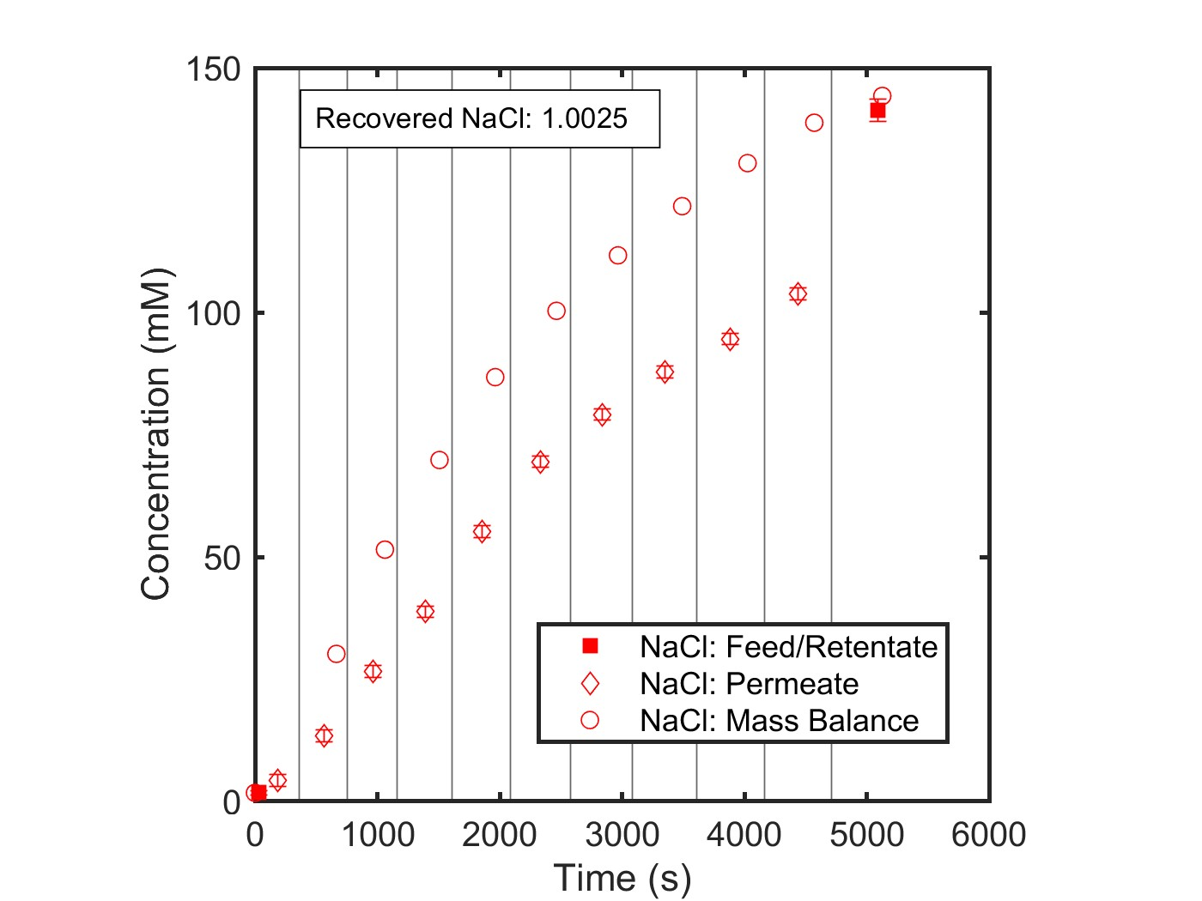
NF270_MC5, 05.27.26_NaCl
Data Quality: Excellent
Single Salt: NaCl
Feed: 1 mM
Diafiltrate: 150 mM

Slide 13
Single Salt
Calcium Chloride Experiments

Slide 14
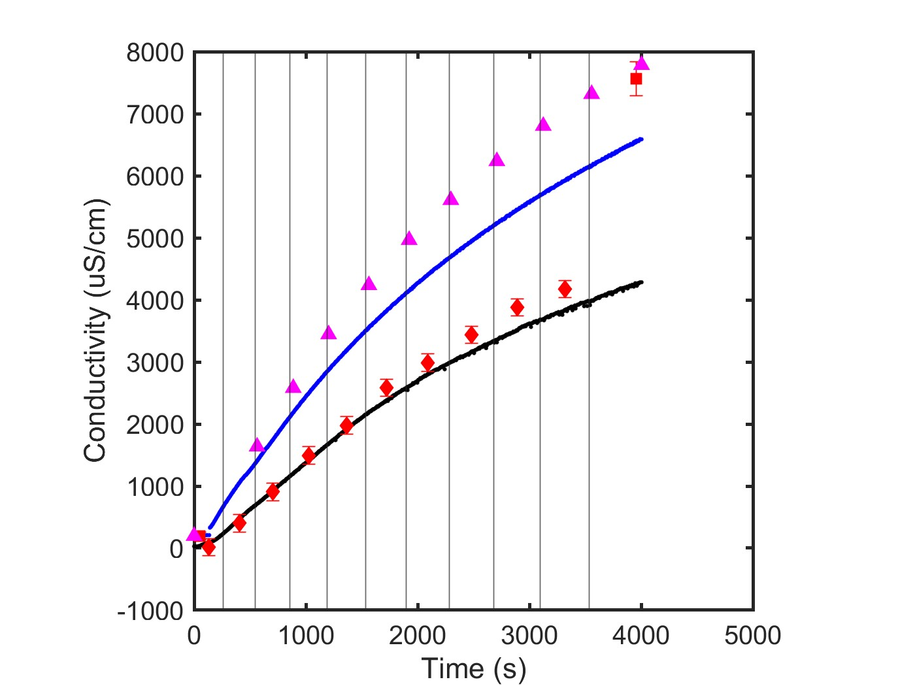
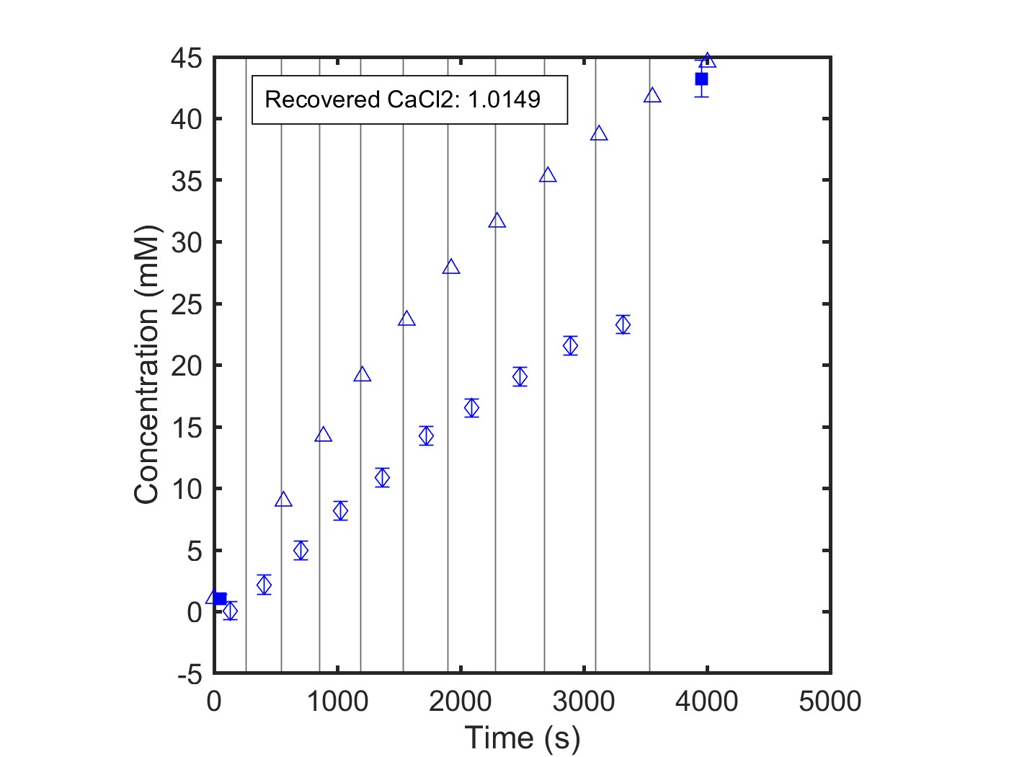
NF270_MC2, 05.07.24_CaCl2
Data Quality: Good
Single Salt: CaCl2
Feed: 1 mM
Diafiltrate: 50 mM

Slide 15
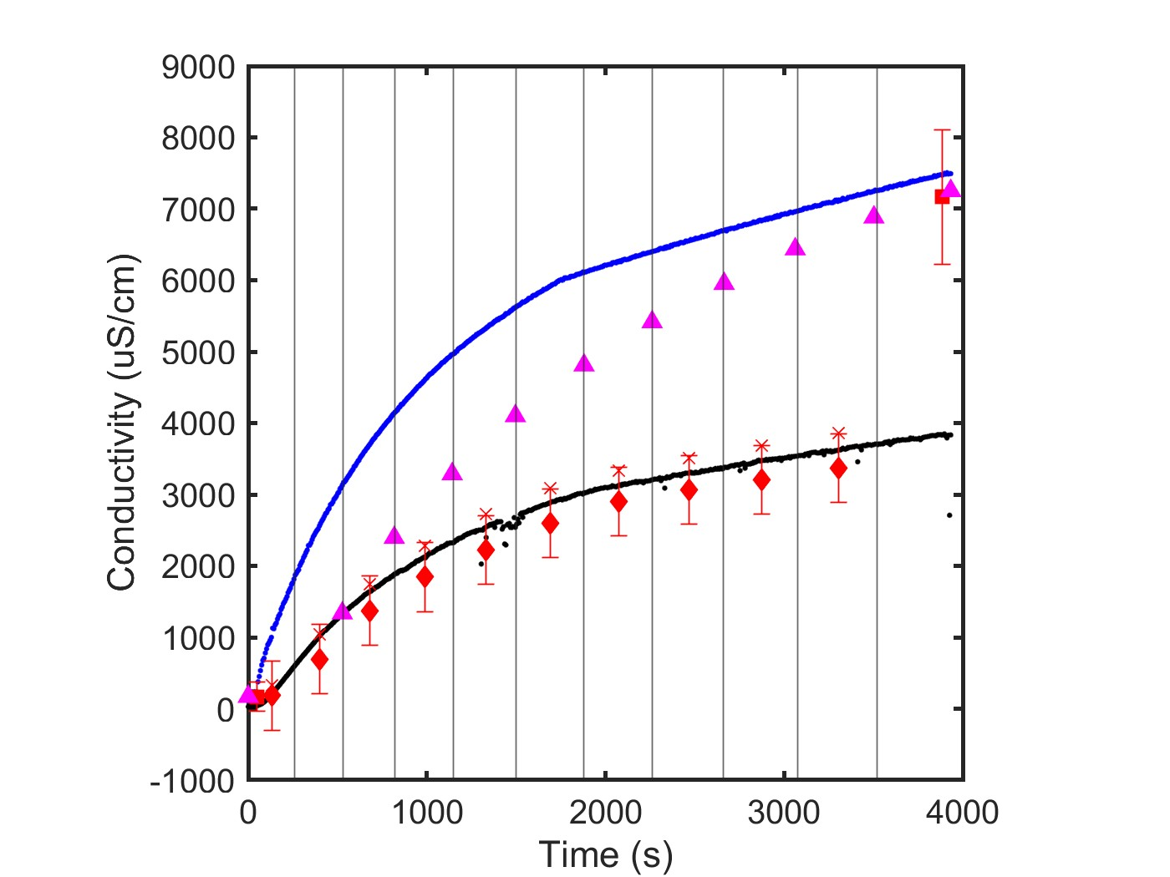
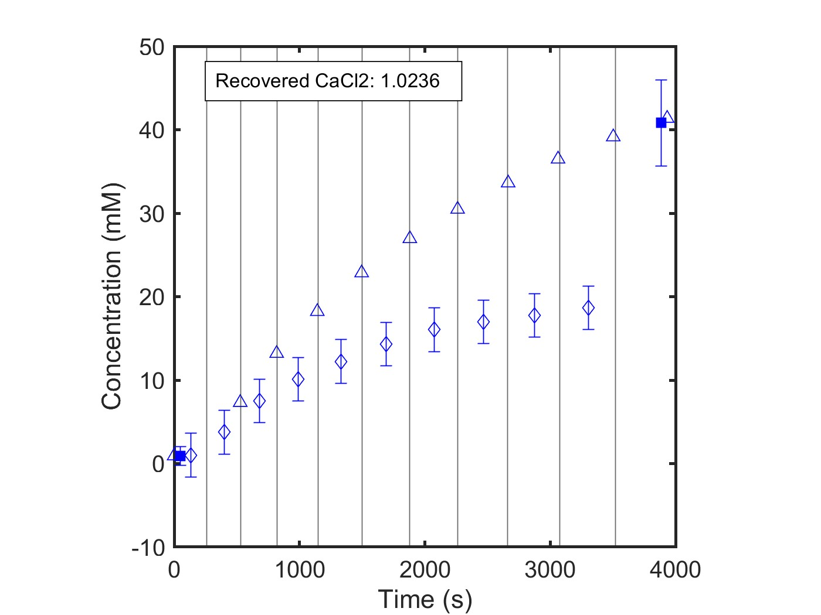
NF270_MC3, 07.11.24_CaCl2
Data Quality: Good
Single Salt: CaCl2
Feed: 1 mM CaCl2
Diafiltrate: 50 mM CaCl2

Slide 16
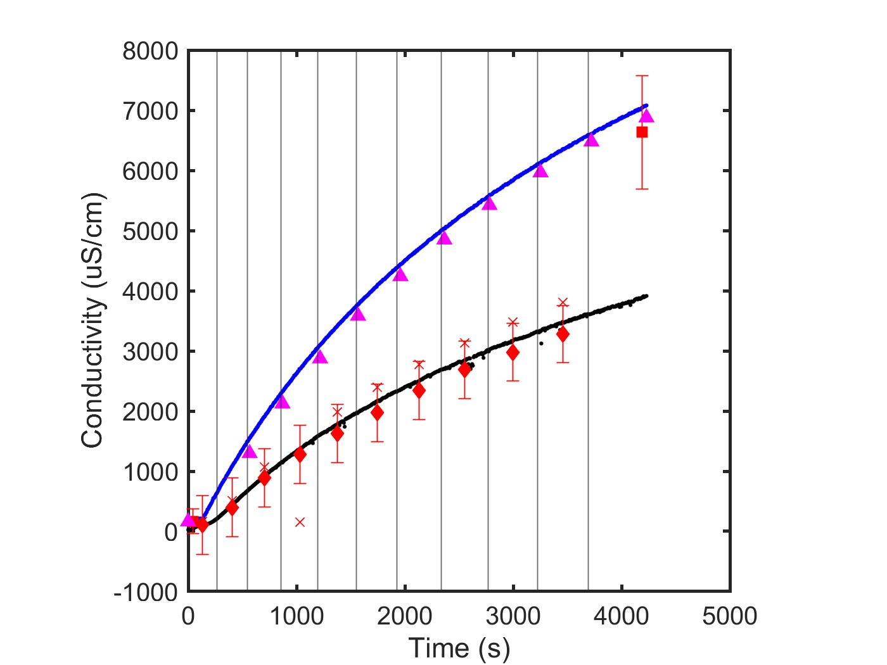
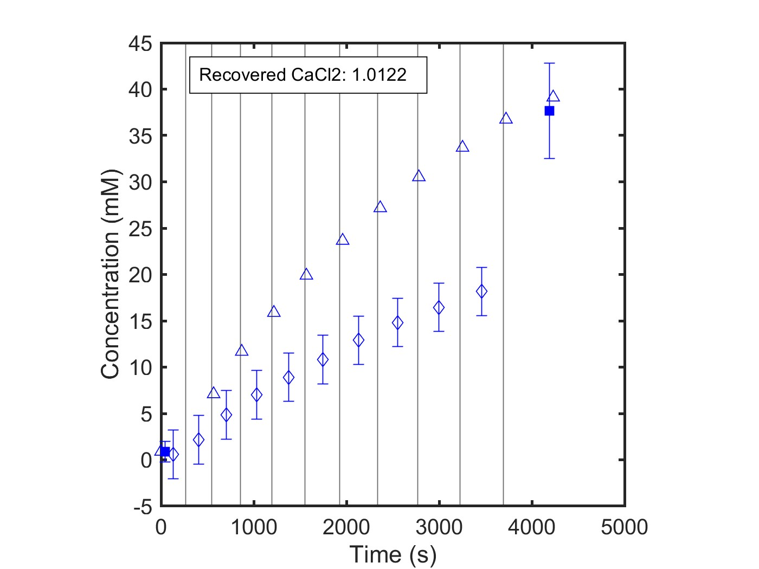
NF270_MC3, 07.11.24_SCaCl2
Data Quality: Good
Single Salt: CaCl2
Feed: 1 mM CaCl2
Diafiltrate: 50 mM CaCl2

Slide 17
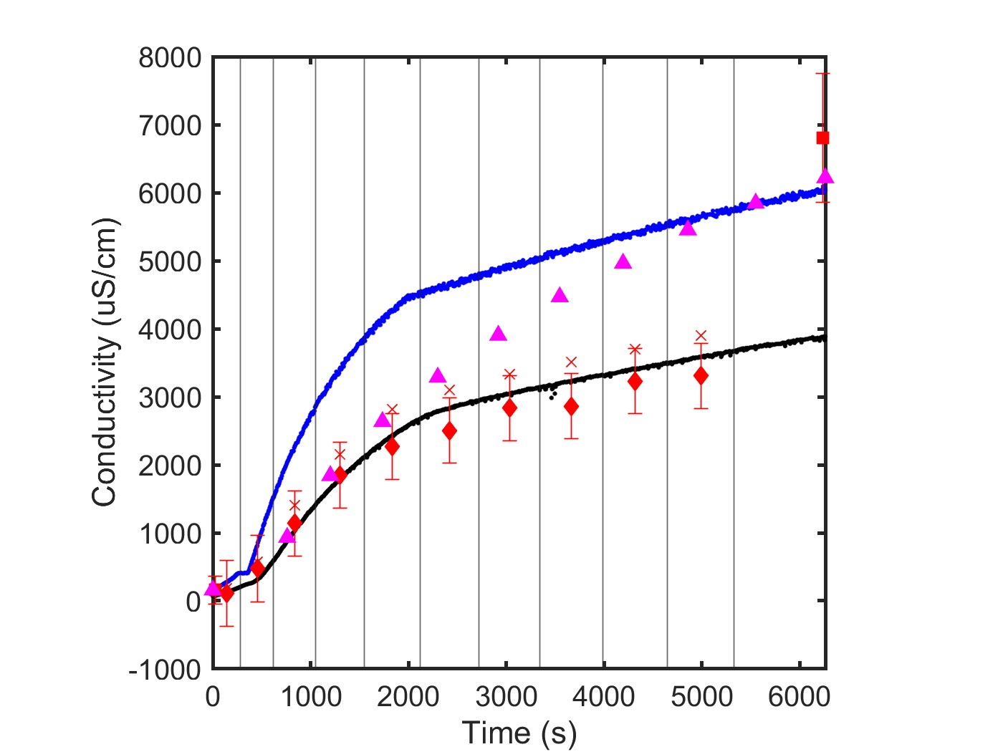
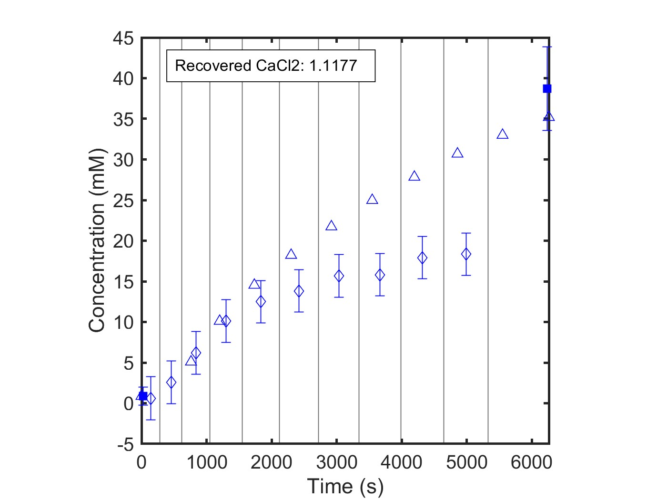
NF270_MC3, 07.12.24_S2CaCl2
Data Quality: Bad
Single Salt: CaCl2
Feed: 1 mM CaCl2
Diafiltrate: 50 mM CaCl2

Slide 18
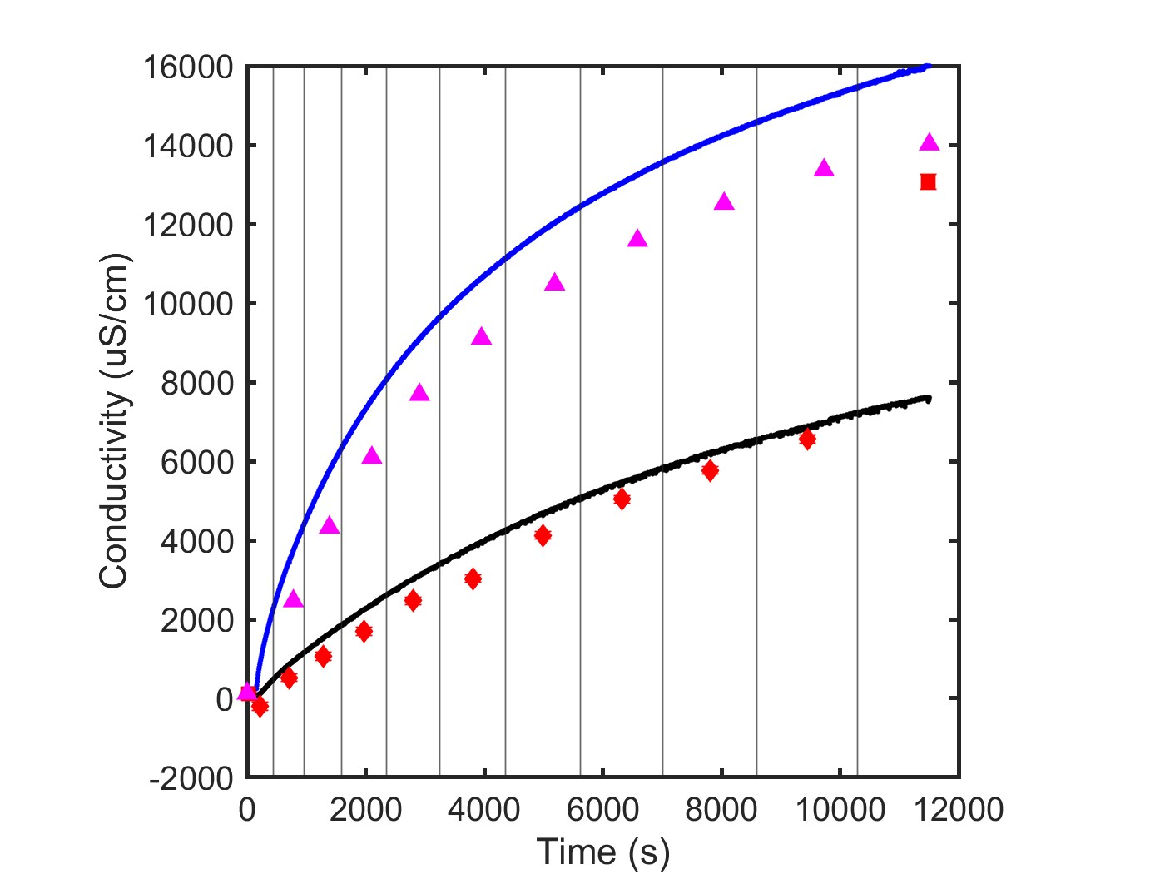
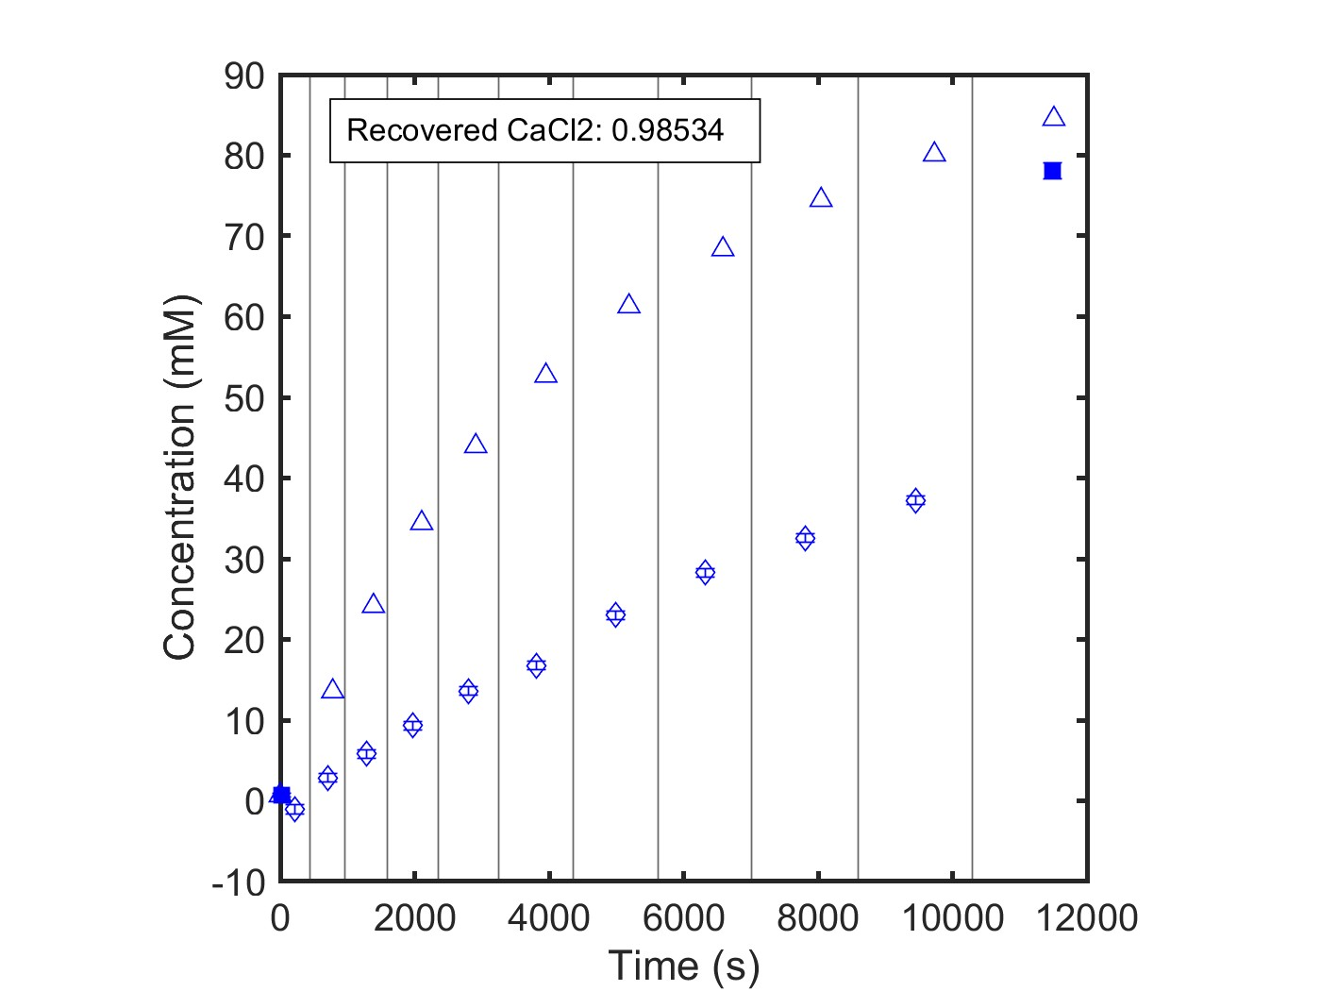
NF270_MC5, 05.27.26_CaCl2
Data Quality: Good
Single Salt: CaCl2
Feed: 1 mM CaCl2
Diafiltrate: 75 mM CaCl2

Slide 19
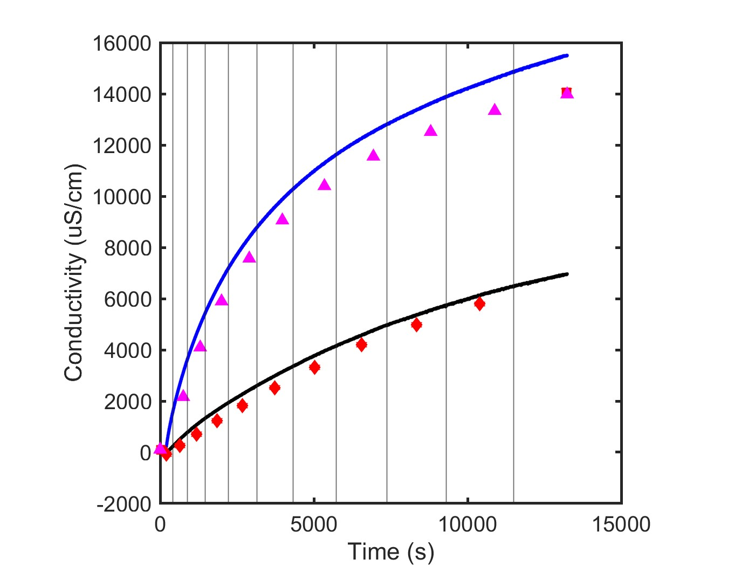
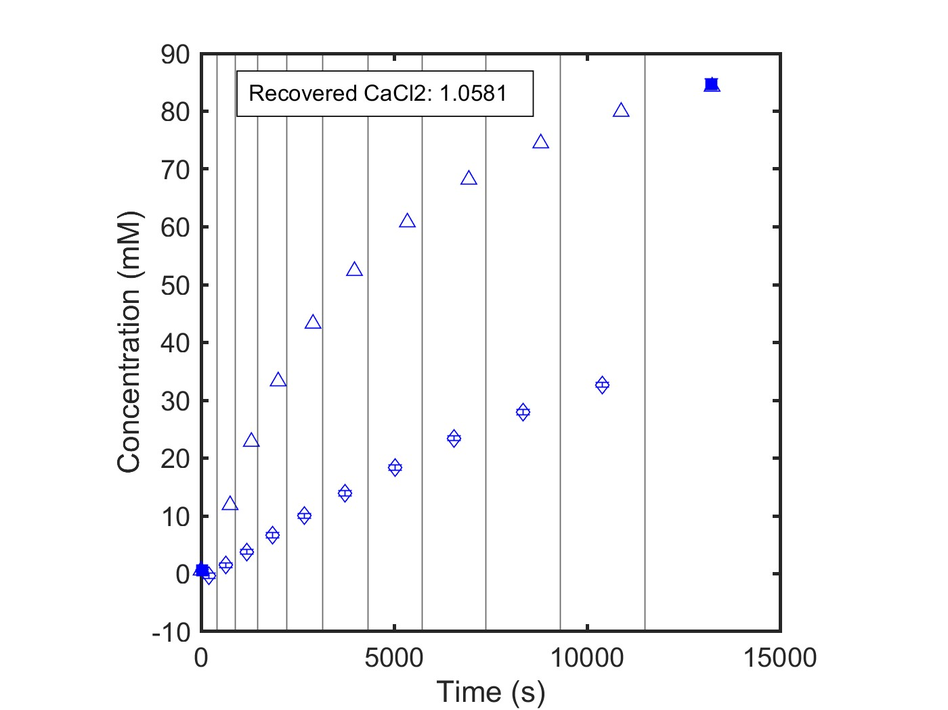
NF270_MC5, 06.27.26_CaCl2
Data Quality: Good
Single Salt: CaCl2
Feed: 1 mM CaCl2
Diafiltrate: 75 mM CaCl2

Slide 20
Single Salt
Lanthanum Chloride Experiments

Slide 21
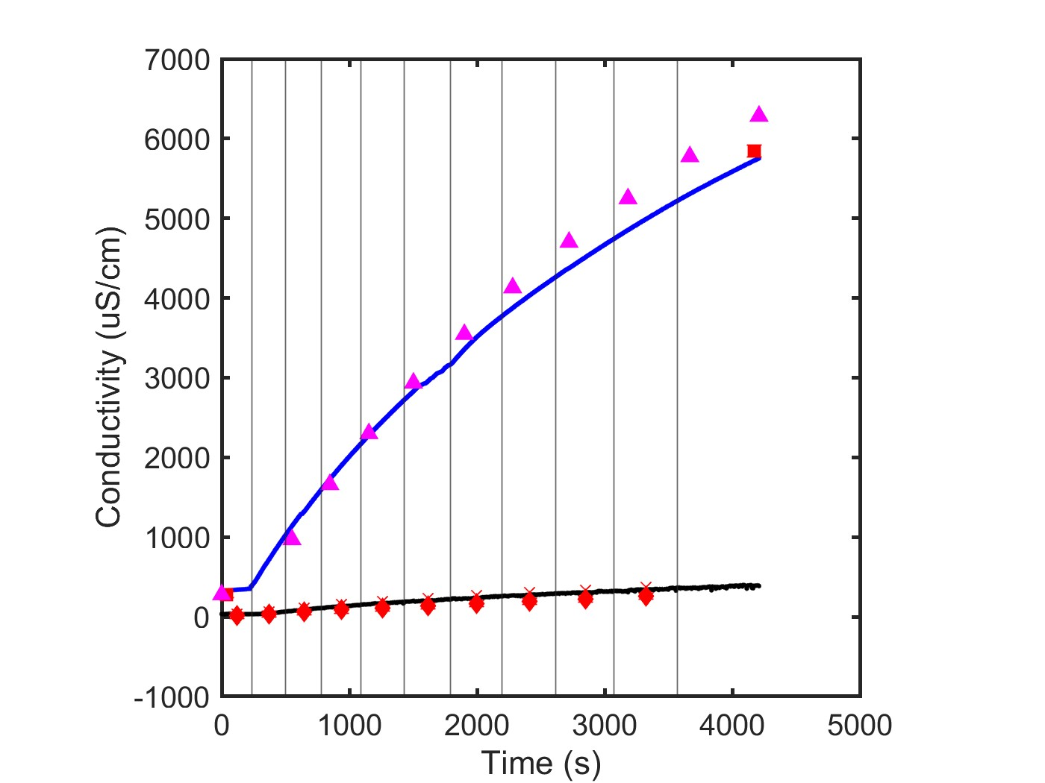
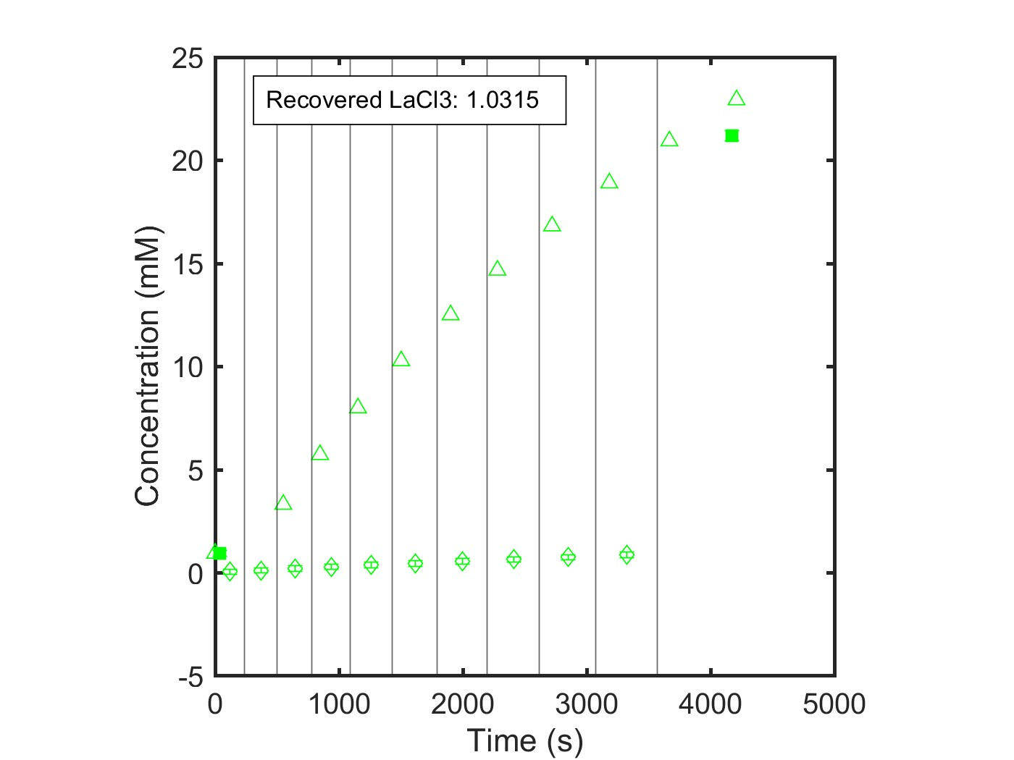
NF270_MC2, 05.21.24_LaCl3
Data Quality: Excellent
Single Salt: LaCl3
Feed: 1 mM
Diafiltrate: 20 mM

Slide 22
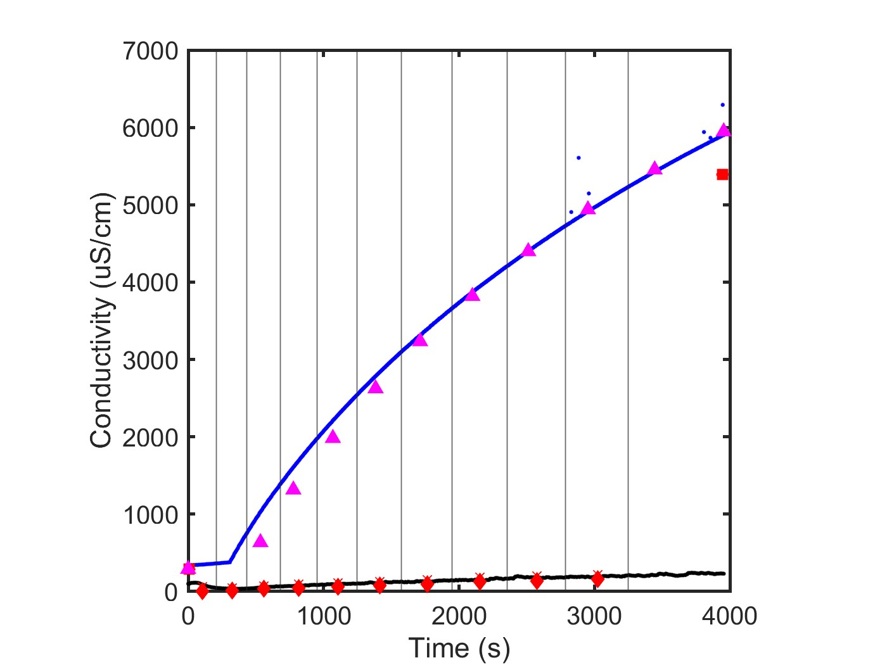
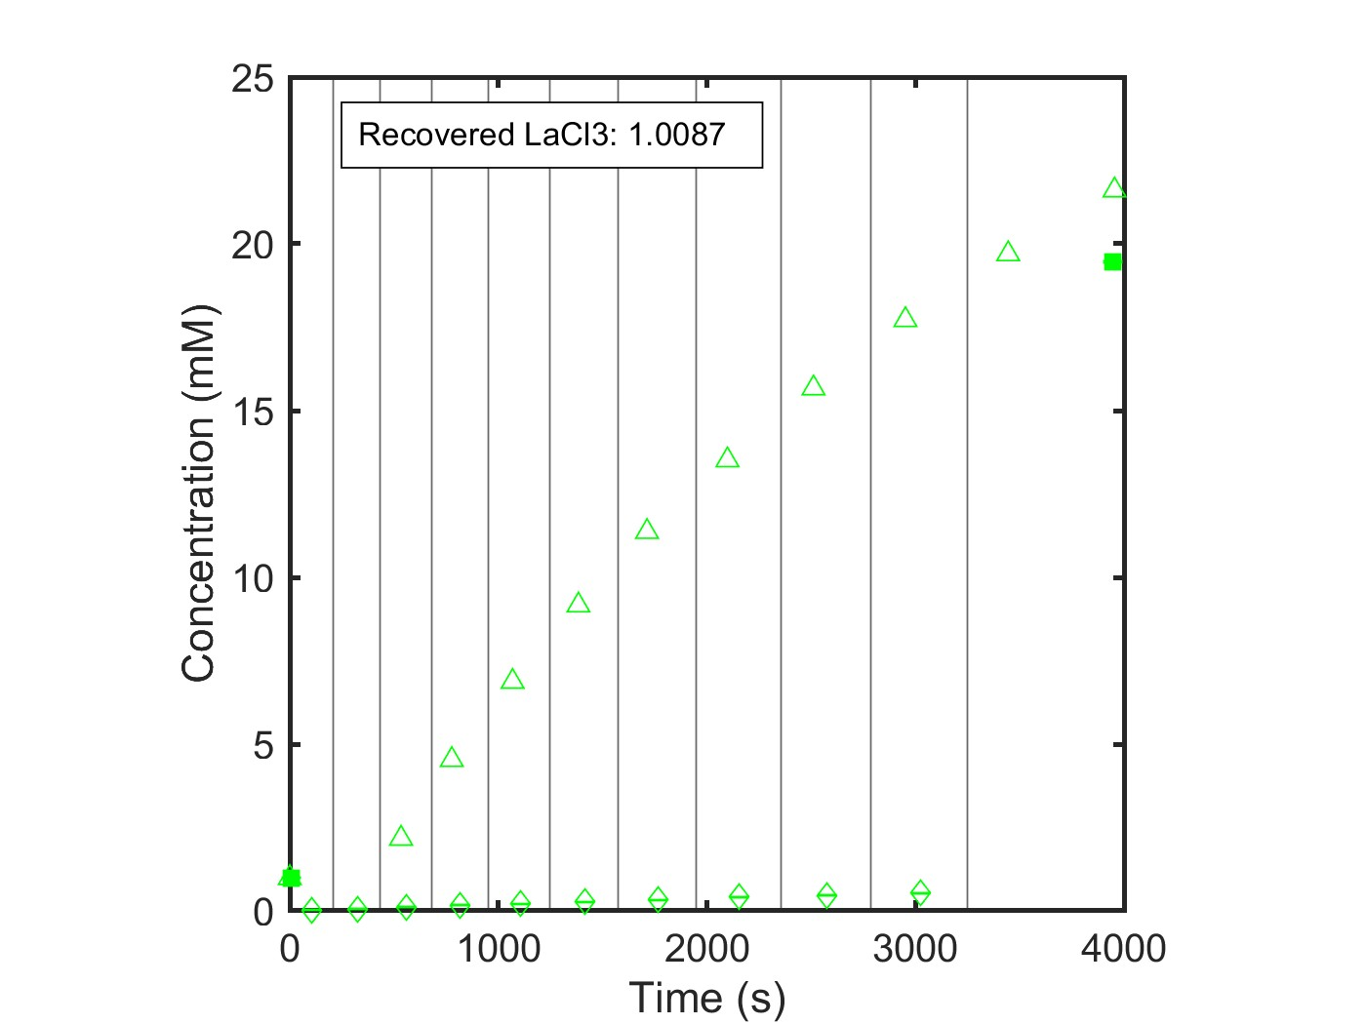
NF270_MC4, 07.11.24_SLaCl3
Data Quality: Good
Single Salt: LaCl3
Feed: 1 mM LaCl3
Diafiltrate: 20 mM LaCl3

Slide 23
Multicomponent Experiments

Slide 24
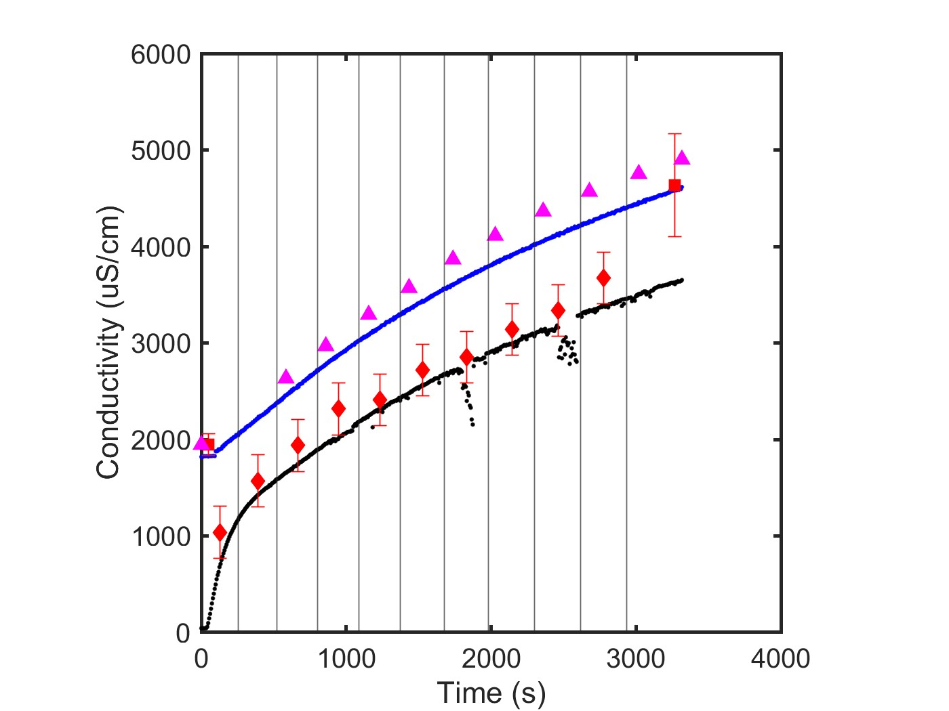
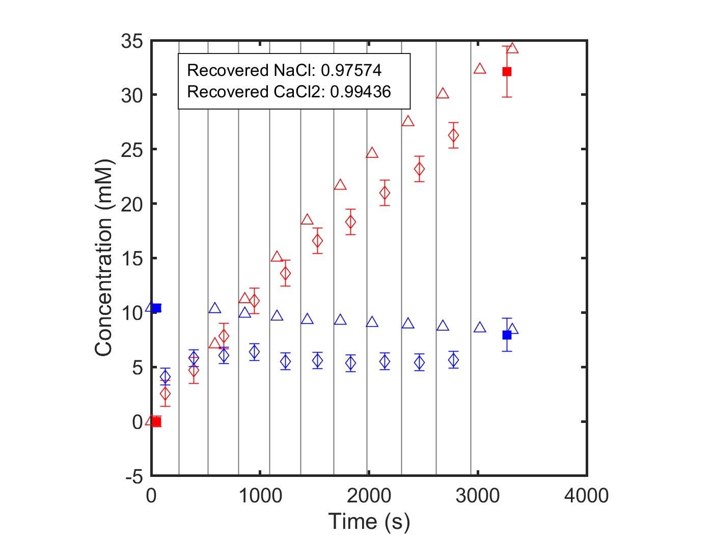
NF270_MC2, 05.08.24_E1
Data Quality: Excellent
Multicomponent: NaCl, CaCl2
Feed: 10 mM CaCl2
Diafiltrate: 4 mM CaCl2; 50 mM NaCl

Slide 25
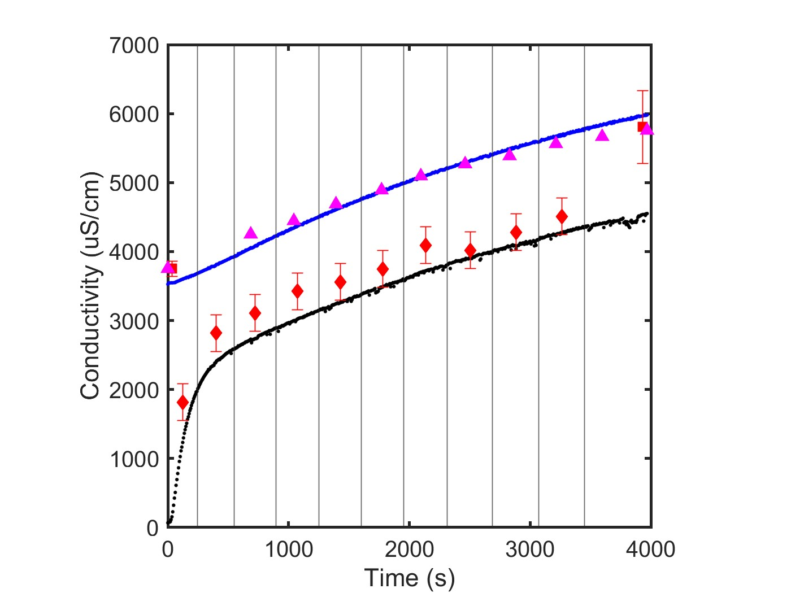
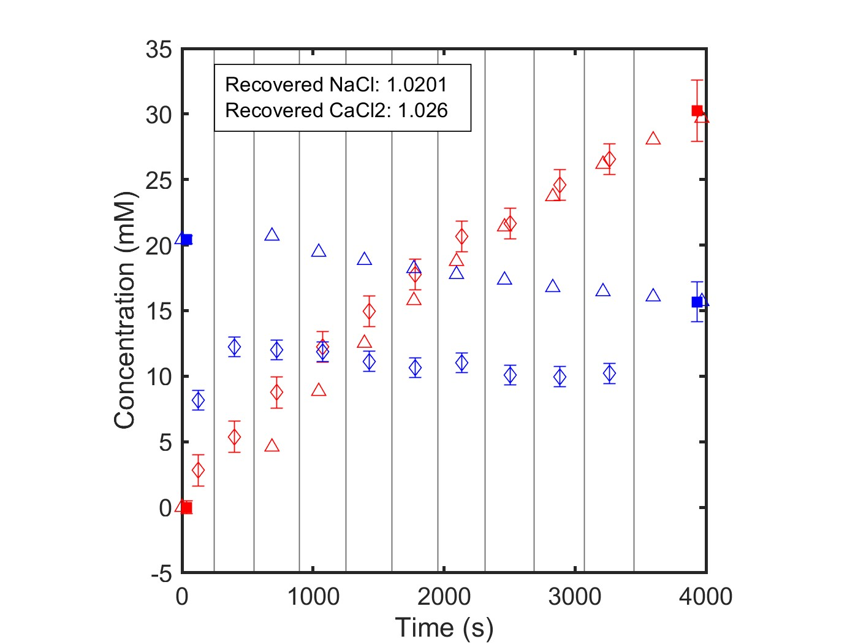
NF270_MC2, 05.08.24_E2
Data Quality: Excellent
Multicomponent: NaCl, CaCl2
Feed: 20 mM CaCl2
Diafiltrate: 8 mM CaCl2; 50 mM NaCl

Slide 26
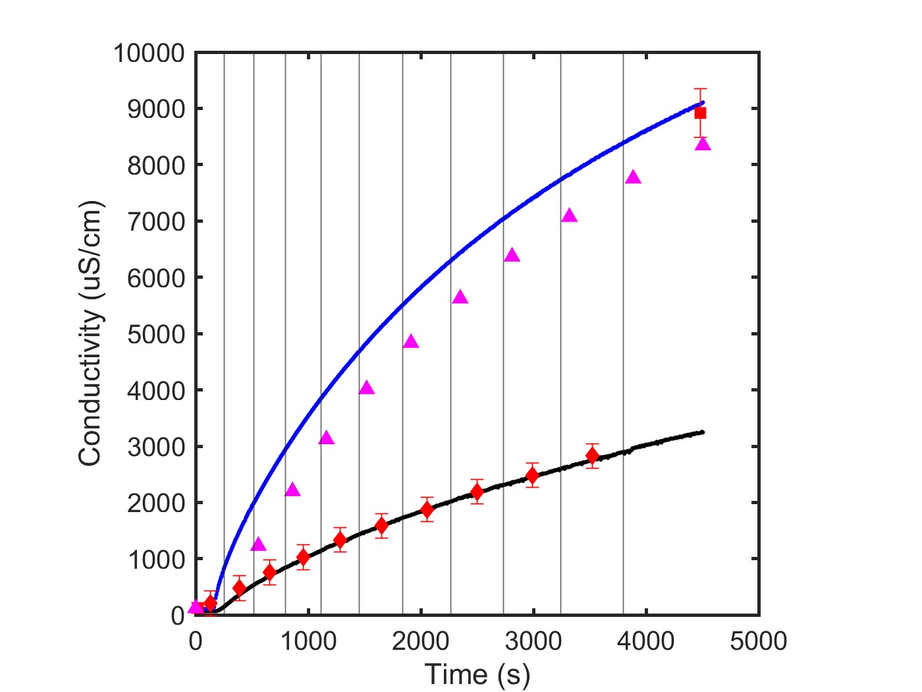
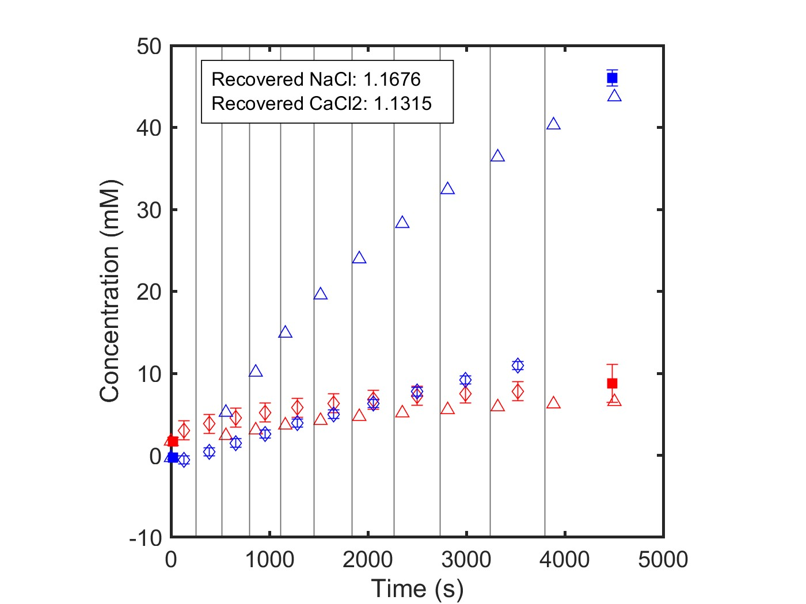
NF270_MC5, 06.01.25_E3
Data Quality: Good
Multicomponent: NaCl, CaCl2
Feed: 10 mM NaCl
Diafiltrate: 5 mM NaCl; 50 mM CaCl2

Slide 27
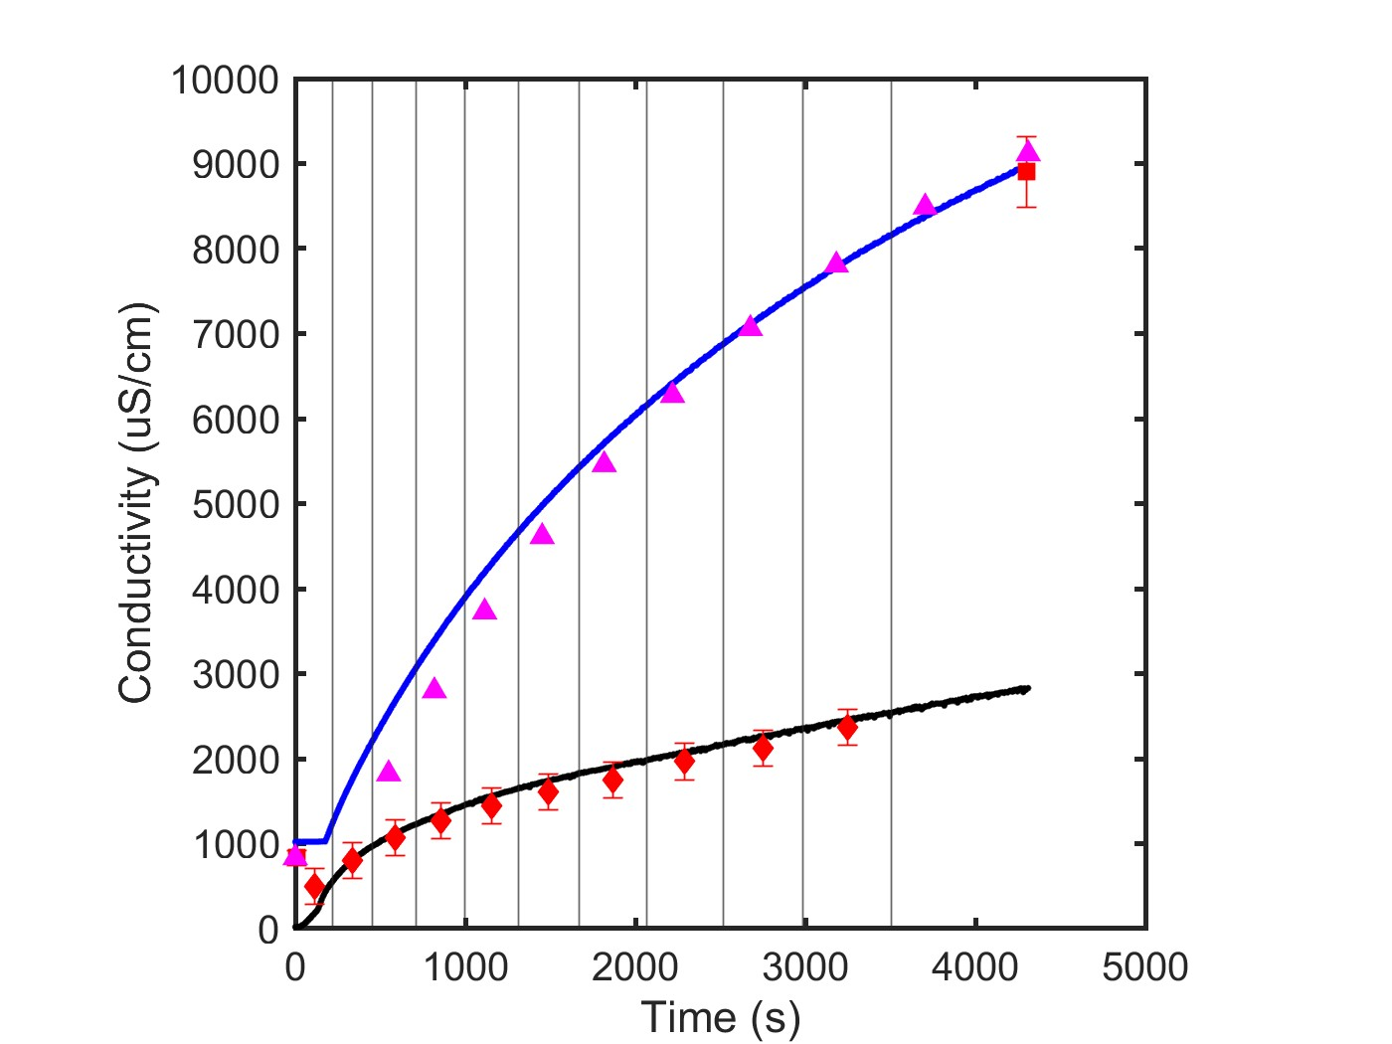
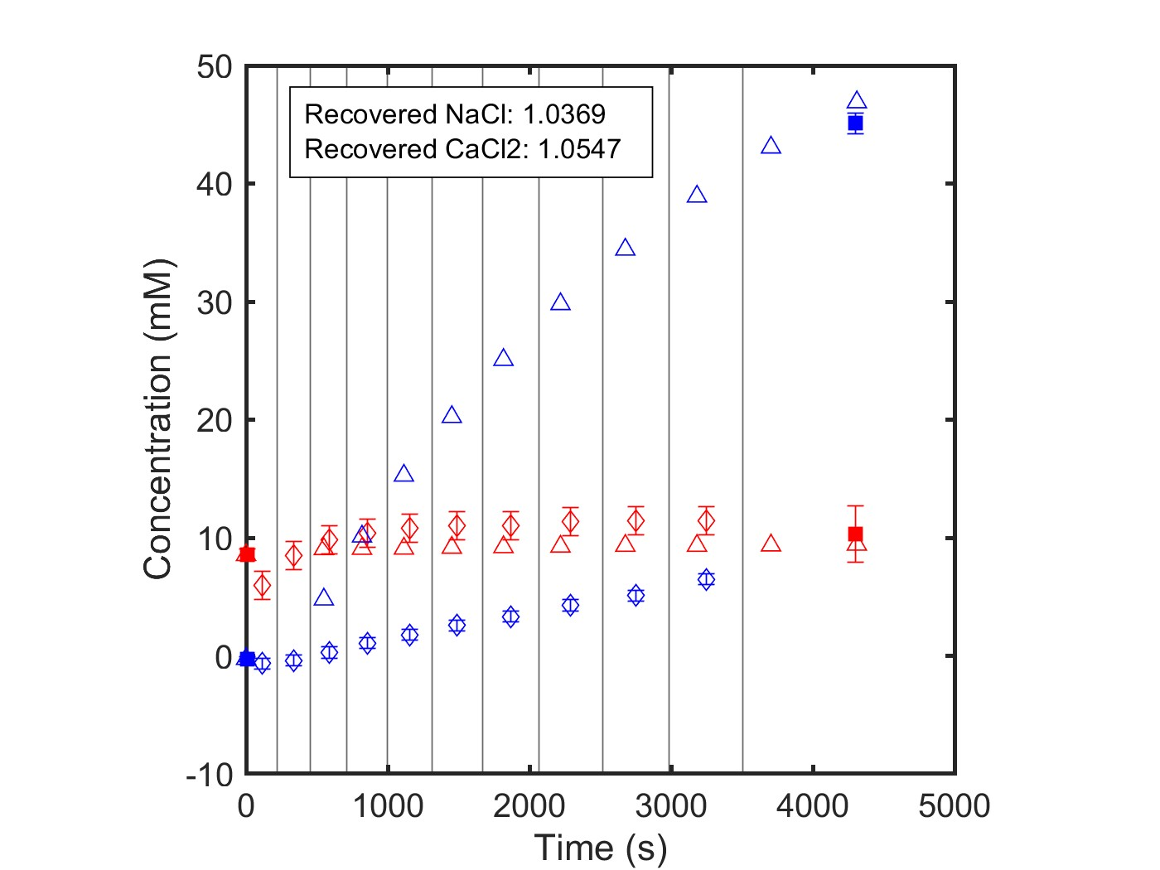
NF270_MC5, 06.05.26_E3
Data Quality: Excellent
Multicomponent: NaCl, CaCl2
Feed: 10 mM NaCl
Diafiltrate: 5 mM NaCl; 50 mM CaCl2

Slide 28
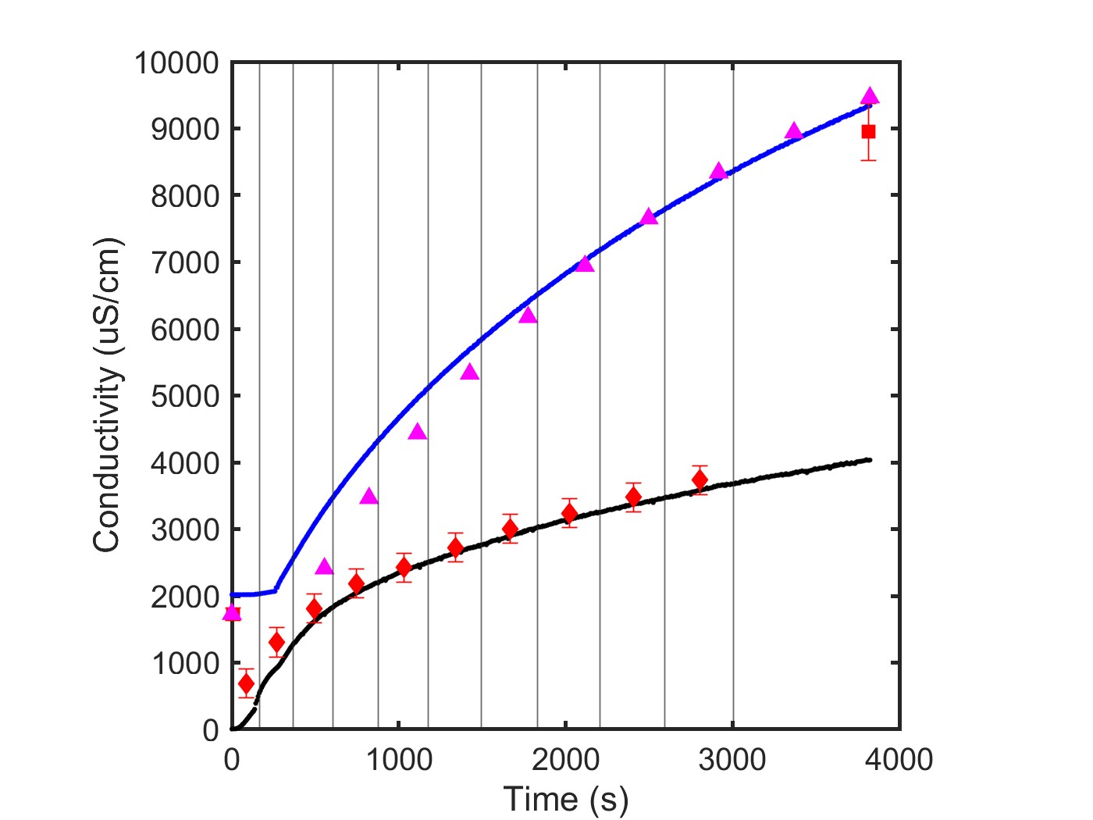
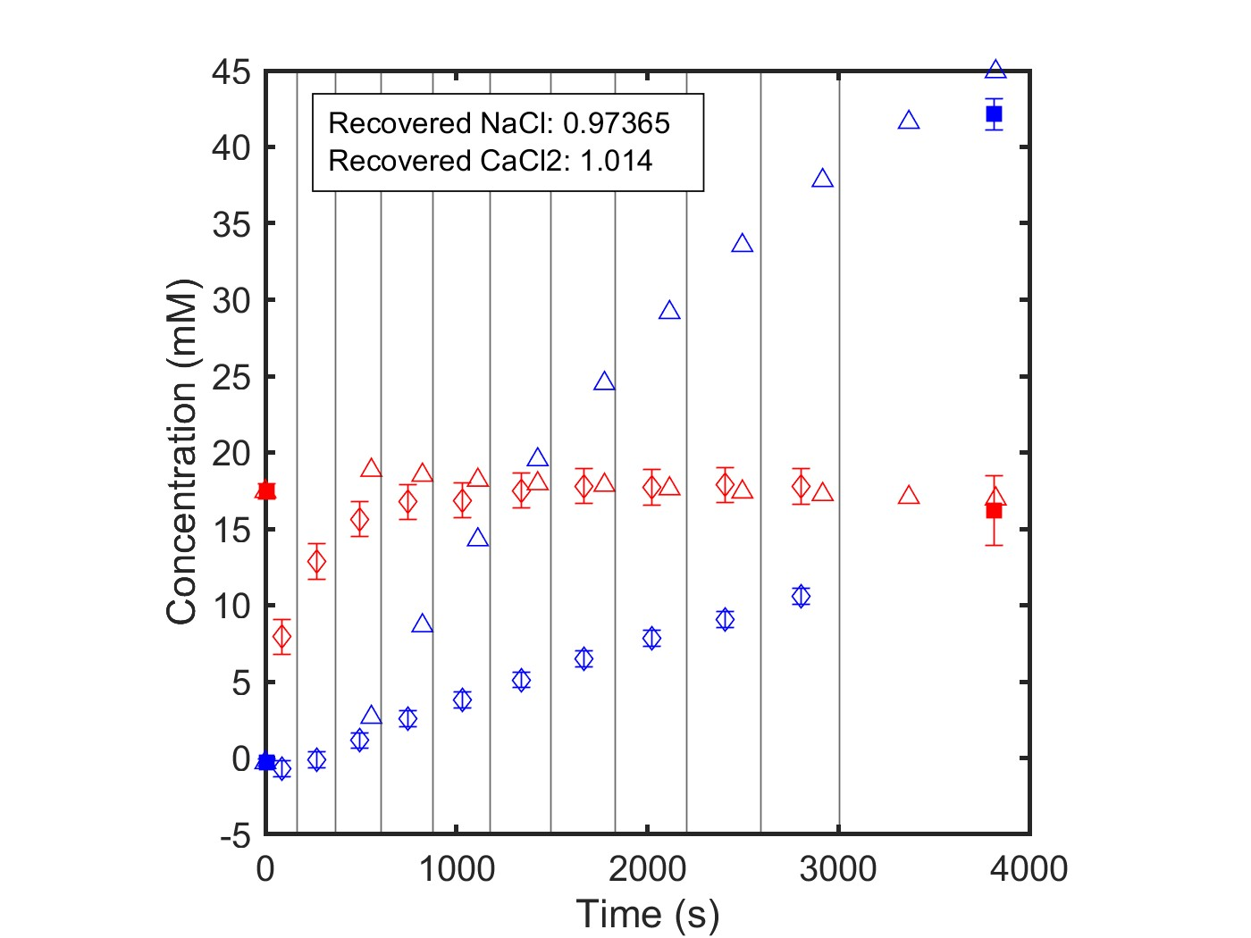
NF270_MC5, 06.01.26_E4
Data Quality: Good
Multicomponent: NaCl, CaCl2
Feed: 20 mM NaCl
Diafiltrate: 10 mM NaCl; 50 mM CaCl2

Slide 29
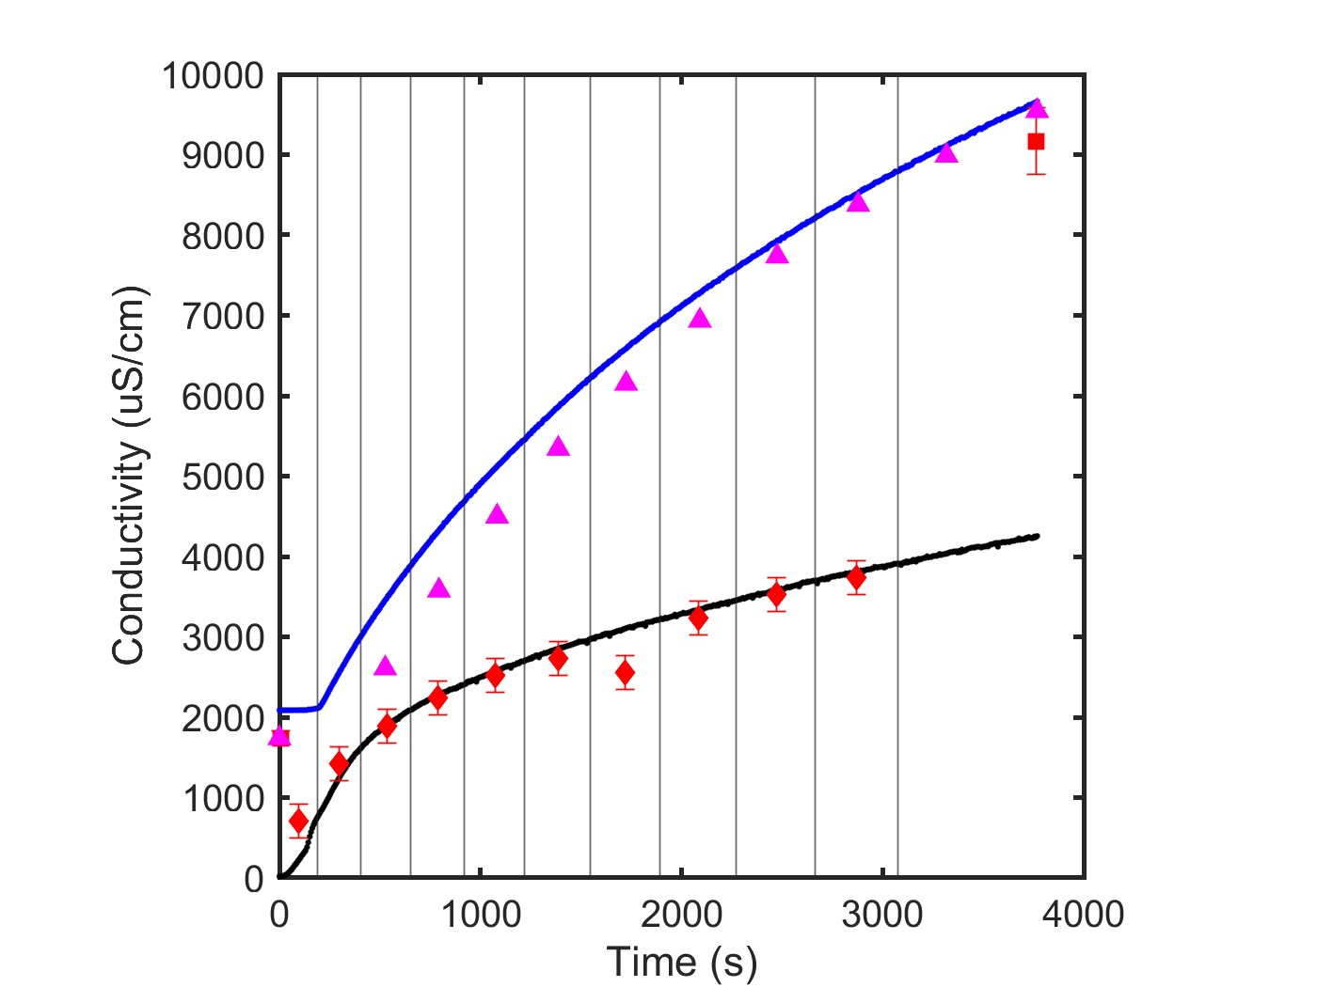
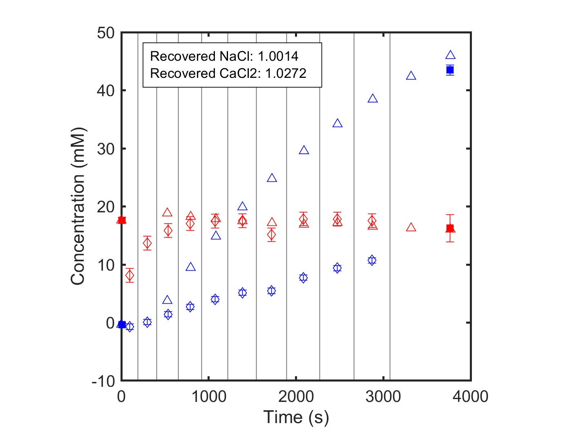
NF270_MC5, 06.05.26_E4
Data Quality: Excellent
Multicomponent: NaCl, CaCl2
Feed: 20 mM NaCl
Diafiltrate: 10 mM NaCl; 50 mM CaCl2

Slide 30
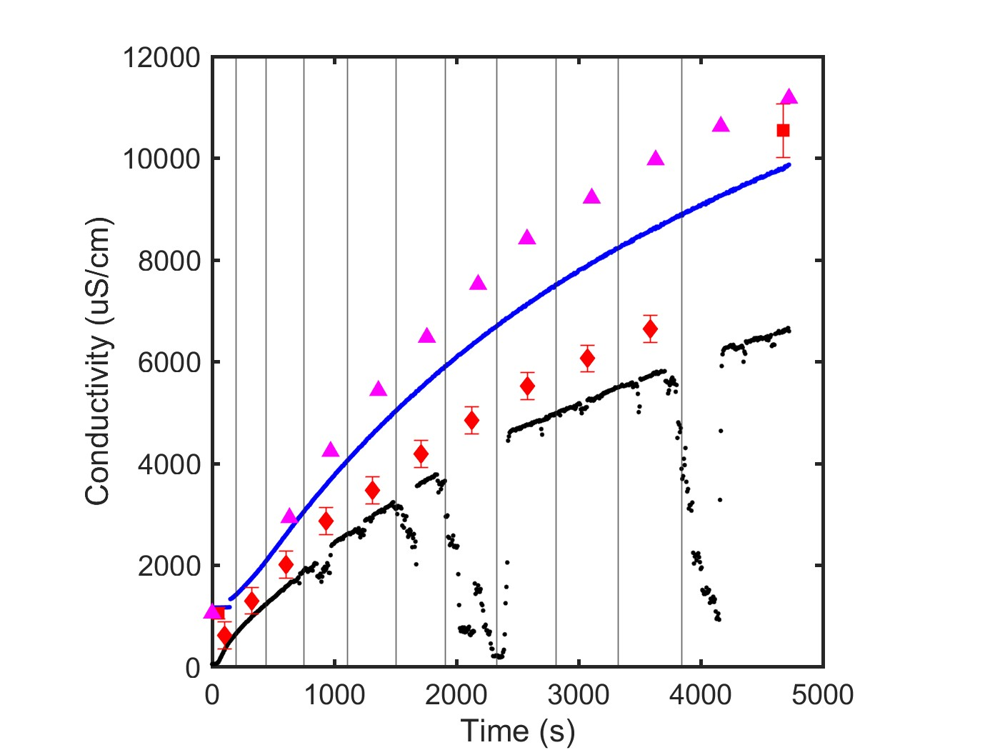
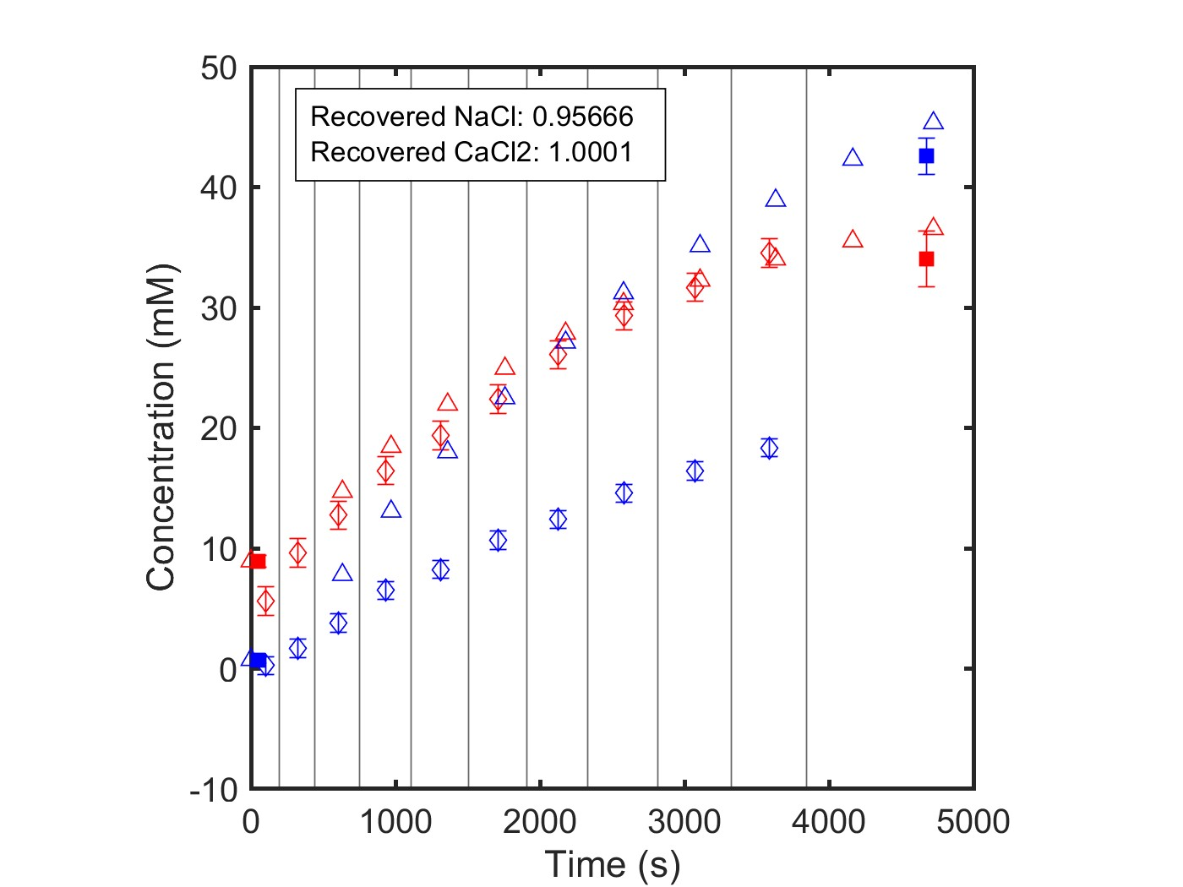
NF270_MC2, 05.09.24_E5
Data Quality: Good
Multicomponent: NaCl, CaCl2
Feed: 10 mM NaCl; 1 mM CaCl2
Diafiltrate: 50 mM NaCl; 50 mM CaCl2

Slide 31
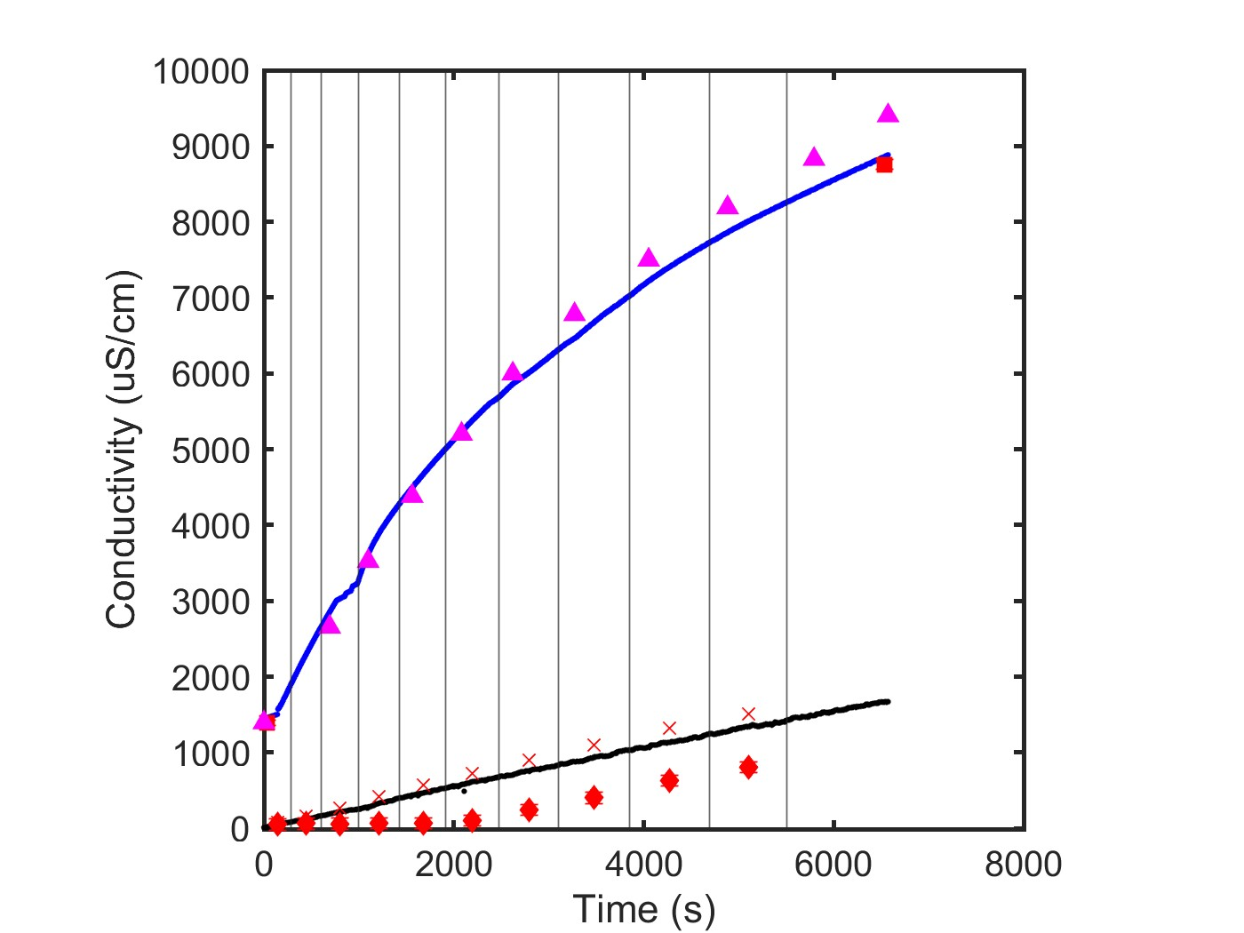

NF270_MC2, 05.21.24_E6
Data Quality: Good
Multicomponent: CaCl2, LaCl3
Feed: 5 mM LaCl3
Diafiltrate: 0.4 mM LaCl3; 50 mM CaCl2

Slide 32


NF270_MC2, 05.21.24_E7
Data Quality: Good
Multicomponent: CaCl2, LaCl3
Feed: 10 mM LaCl3
Diafiltrate: 0.4 mM LaCl3; 50 mM CaCl2

Slide 33


NF270_MC2, 05.22.24_E8
Data Quality: Good
Multicomponent: CaCl2, LaCl3
Feed: 10 mM CaCl2
Diafiltrate: 6 mM CaCl2; 15 mM LaCl3

Slide 34


NF270_MC2, 05.22.24_E9
NEEDS TO BE RERUN
Data Quality: Excellent, but LaCl3 concentration is essentially zero
Multicomponent: CaCl2, LaCl3
Feed: 20 mM CaCl2
Diafiltrate: 12 mM CaCl2; 15 mM LaCl3

Slide 35


NF270_MC5, 09.08.25_E9
Data Quality: Good
Multicomponent: CaCl2, LaCl3
Feed: 20 mM CaCl2
Diafiltrate: 12 mM CaCl2; 15 mM LaCl3

Slide 36


NF270_MC2, 05.22.24_E10
Data Quality: Good
Multicomponent: CaCl2, LaCl3
Feed: 1 mM LaCl3; 5 mM CaCl2
Diafiltrate: 10 mM LaCl3; 25 mM CaCl2

Slide 37


NF270_MC2, 05.28.24_E11
Data Quality: Excellent
Multicomponent: NaCl, LaCl3
Feed: 10 mM NaCl
Diafiltrate: 5 mM NaCl; 15 mM LaCl3

Slide 38


NF270_MC2, 05.28.24_E12
Data Quality: Excellent
Multicomponent: NaCl, LaCl3
Feed: 20 mM NaCl
Diafiltrate: 10 mM NaCl; 15 mM LaCl3

Slide 39


NF270_MC2, 05.29.24_E13
RERUN ON MF270_MC4
Data Quality: Good
Multicomponent: NaCl, LaCl3
Feed: 5 mM LaCl3
Diafiltrate: 0.2 mM LaCl3; 50 mM NaCl

Slide 40


NF270_MC4, 07.12.24_E13
Data Quality: Excellent
Multicomponent: NaCl, LaCl3
Feed: 5 mM LaCl3
Diafiltrate: 0.2 mM LaCl3; 50 mM NaCl

Slide 41


NF270_MC2, 05.29.24_E14
RERUN ON NF270_MC4
Data Quality: Okay
Multicomponent: NaCl, LaCl3
Feed: 10 mM LaCl3
Diafiltrate: 0.4 mM LaCl3; 50 mM NaCl

Slide 42


NF270_MC4, 07.15.25_E14
NEEDS TO BE RERUN
Data Quality: Bad
Multicomponent: NaCl, LaCl3
Feed: 10 mM LaCl3
Diafiltrate: 0.4 mM LaCl3; 50 mM NaCl

Slide 43


NF270_MC5, 09.09.25_E14
Data Quality: Excellent
Multicomponent: NaCl, LaCl3
Feed: 10 mM LaCl3
Diafiltrate: 0.4 mM LaCl3; 50 mM NaCl

Slide 44


NF270_MC2, 05.30.24_E15
Data Quality: Excellent
Multicomponent: NaCl, LaCl3
Feed: 10 mM NaCl; 1 mM LaCl3
Diafiltrate: 50 mM NaCl; 10 mM LaCl3

Slide 45


NF270_MC5, 07.16.24_E16
Data Quality: Excellent
Multicomponent: NaCl, LaCl3
Feed: 50 mM NaCl; 1 mM LaCl3
Diafiltrate: 10 mM NaCl; 20 mM LaCl3

Slide 46


NF270_MC5, 06.01.26_E16
Data Quality: Excellent
Multicomponent: NaCl, LaCl3
Feed: 50 mM NaCl; 1 mM LaCl3
Diafiltrate: 10 mM NaCl; 20 mM LaCl3

Slide 47


NF270_MC4, 07.16.24_E17
Data Quality: Excellent
Multicomponent: CaCl2, LaCl3
Feed: 50 mM CaCl2; 1 mM LaCl3
Diafiltrate: 20 mM LaCl3

